Slide 1
MIT IAP SERIES 2022
DUAL-USE VENTURES
Navigating both commercial and defense markets
JANUARY 19, 2022

Slide 2
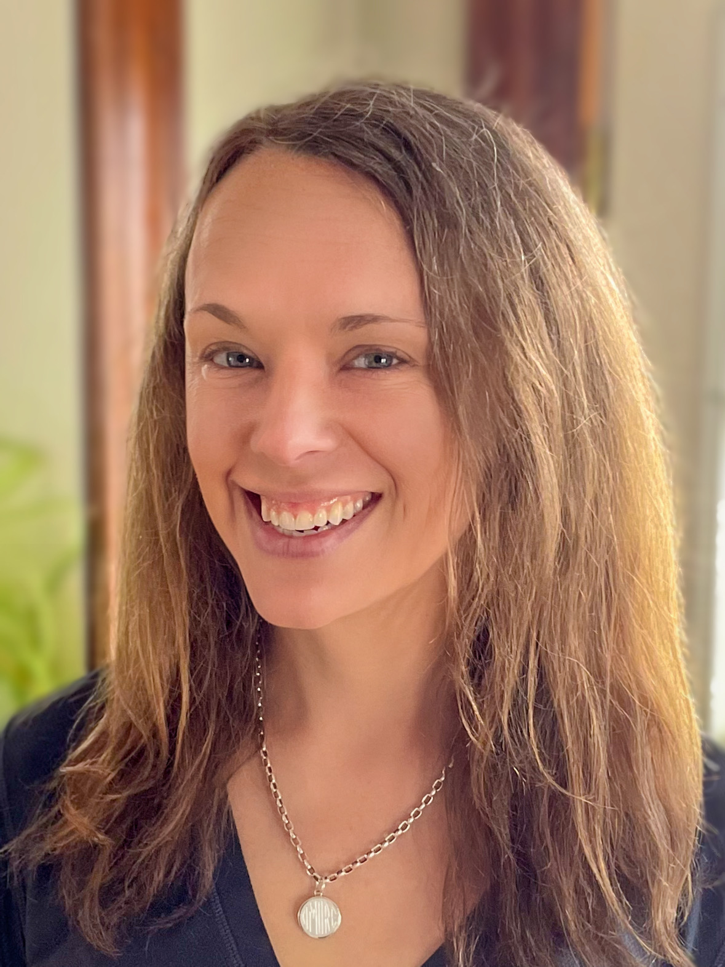
DUAL-USE VENTURES
Navigating both commercial and defense markets
KATY PERSON
Program Manager, Mission Innovation Program
MIT Innovation Initiative
Jan 19–21, 2022

Slide 3
MIT IAP 2022: Navigating both commercial and defense markets
Specializing in defense startups, Katy collaborates with DoD organizations to link tough tech startups with defense buyers. She’s conducted workshops on dual-use ventures and coached tough tech startups seeking defense customers. She’s also written on the topic of regional economic engagement within the Defense Laboratory Enterprise, served as panelist on innovation panels, hosted US and NATO commanders on MIT's campus, and delivered a keynote speech for the City of Cambridge on Memorial Day.
From 2003–2016 she served on active-duty US Army officer with operational, program management, and technology development assignments, including tours with the Assistant Secretary of the Army for Acquisitions, Logistics, and Technology (ASA(ALT)) - Forward, CCDC (previously RDECOM), and the 10th Mountain Division, where she received two Bronze Star Medals in Afghanistan.
DUAL-USE VENTURES
Navigating both commercial and defense markets
KATY PERSON
Program Manager, Mission Innovation Program
MIT Innovation Initiative
Jan 19–21, 2022

Slide 4
AGENDA
WELCOME
SCHEDULE
WHY DEFENSE
KNOW YOUR CUSTOMER
TRLS
RESOURCES
MIT IAP 2022: Navigating both commercial and defense markets
mitii.news/DuVIncubator

Slide 5
MIT IAP 2022: Navigating both commercial and defense markets
WHY STARTUPS SHOULDN’T CONSIDER DEFENSE AS A BEACHHEAD MARKET
S-l-o-w to award a contract
After the contract, your tech/services can be dropped
No loyalty for startups
Hard to find the right person in the organization who needs your tech
Hard to get feedback
“Insider baseball”…?
May be hard to find an investor
IP considerations
Defense prime contractors – the big few – continue to increase market share over the last 4 decades. (Lobbyists?)

Slide 6
MIT IAP 2022: Navigating both commercial and defense markets
DISCLAIMER
This presentation is full of acronyms and jargon.
Our audience has a wide range of experience and familiarity with DoD, including undergrads, post-docs, seasoned defense tech founders, career-long DoD employees, etc.
Please type in chat when you need me or a classmate to define an acronym or term.
If you don’t get the answer you need, stay tuned. You’ll hear many of these acronyms and terms throughout the course. They will become familiar to you quickly upon repetition.

Slide 7
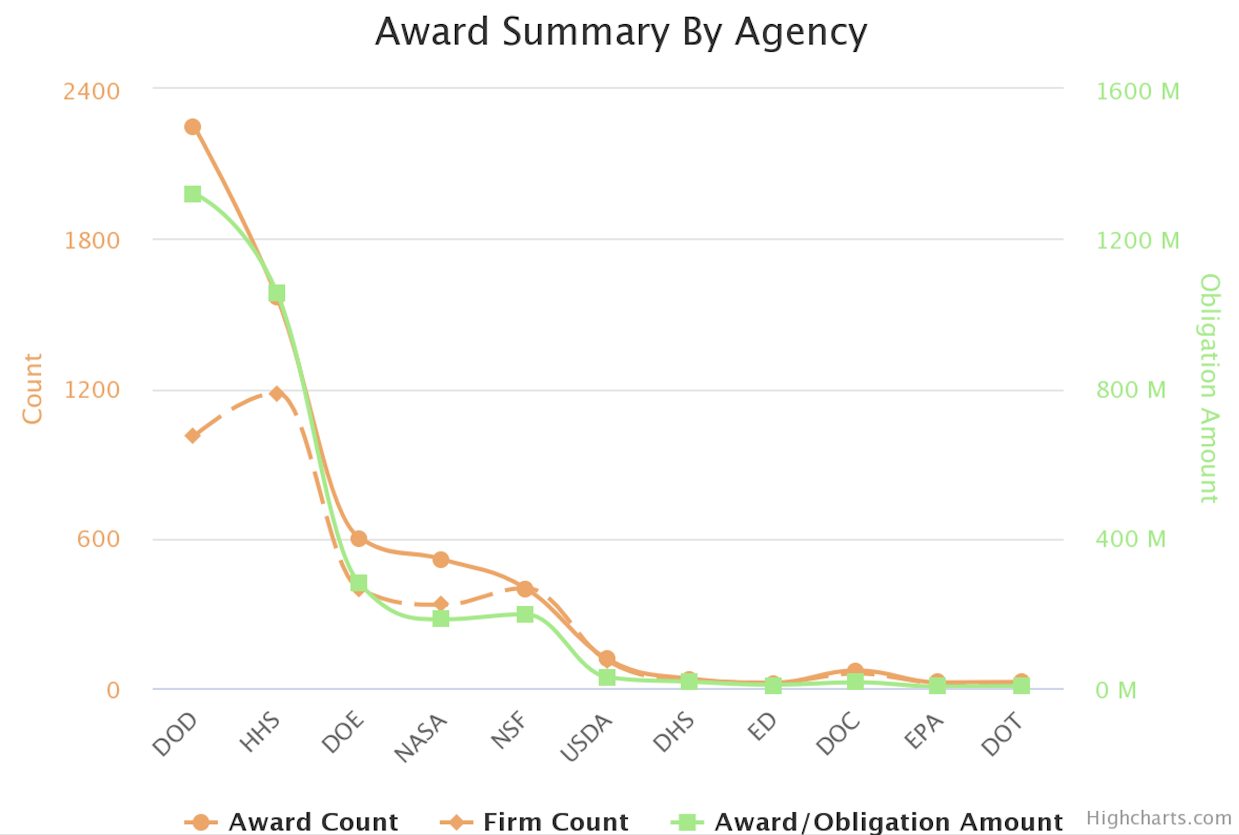
MIT IAP 2022: Navigating both commercial and defense markets
WHY STARTUPS SHOULD CONSIDER DEFENSE AS A BEACHHEAD MARKET
DoD is enormous…
2018 SBIR/STTR Obligations
https://www.sbir.gov/analytics-dashboard?year%5B%5D=2018

Slide 8
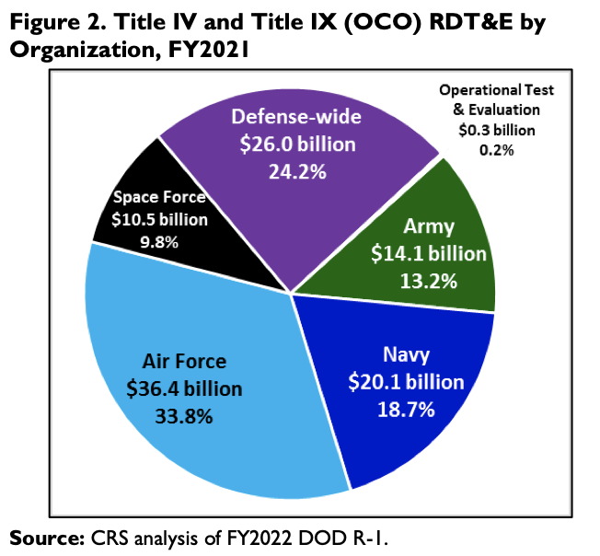
MIT IAP 2022: Navigating both commercial and defense markets
WHY STARTUPS SHOULD CONSIDER DEFENSE AS A BEACHHEAD MARKET
DoD is enormous…
“Defense Primer: RDT&E.” Congressional Research Service (CRS). Updated October 21, 2021. https://crsreports.congress.gov/product/pdf/IF/IF10553.

Slide 9
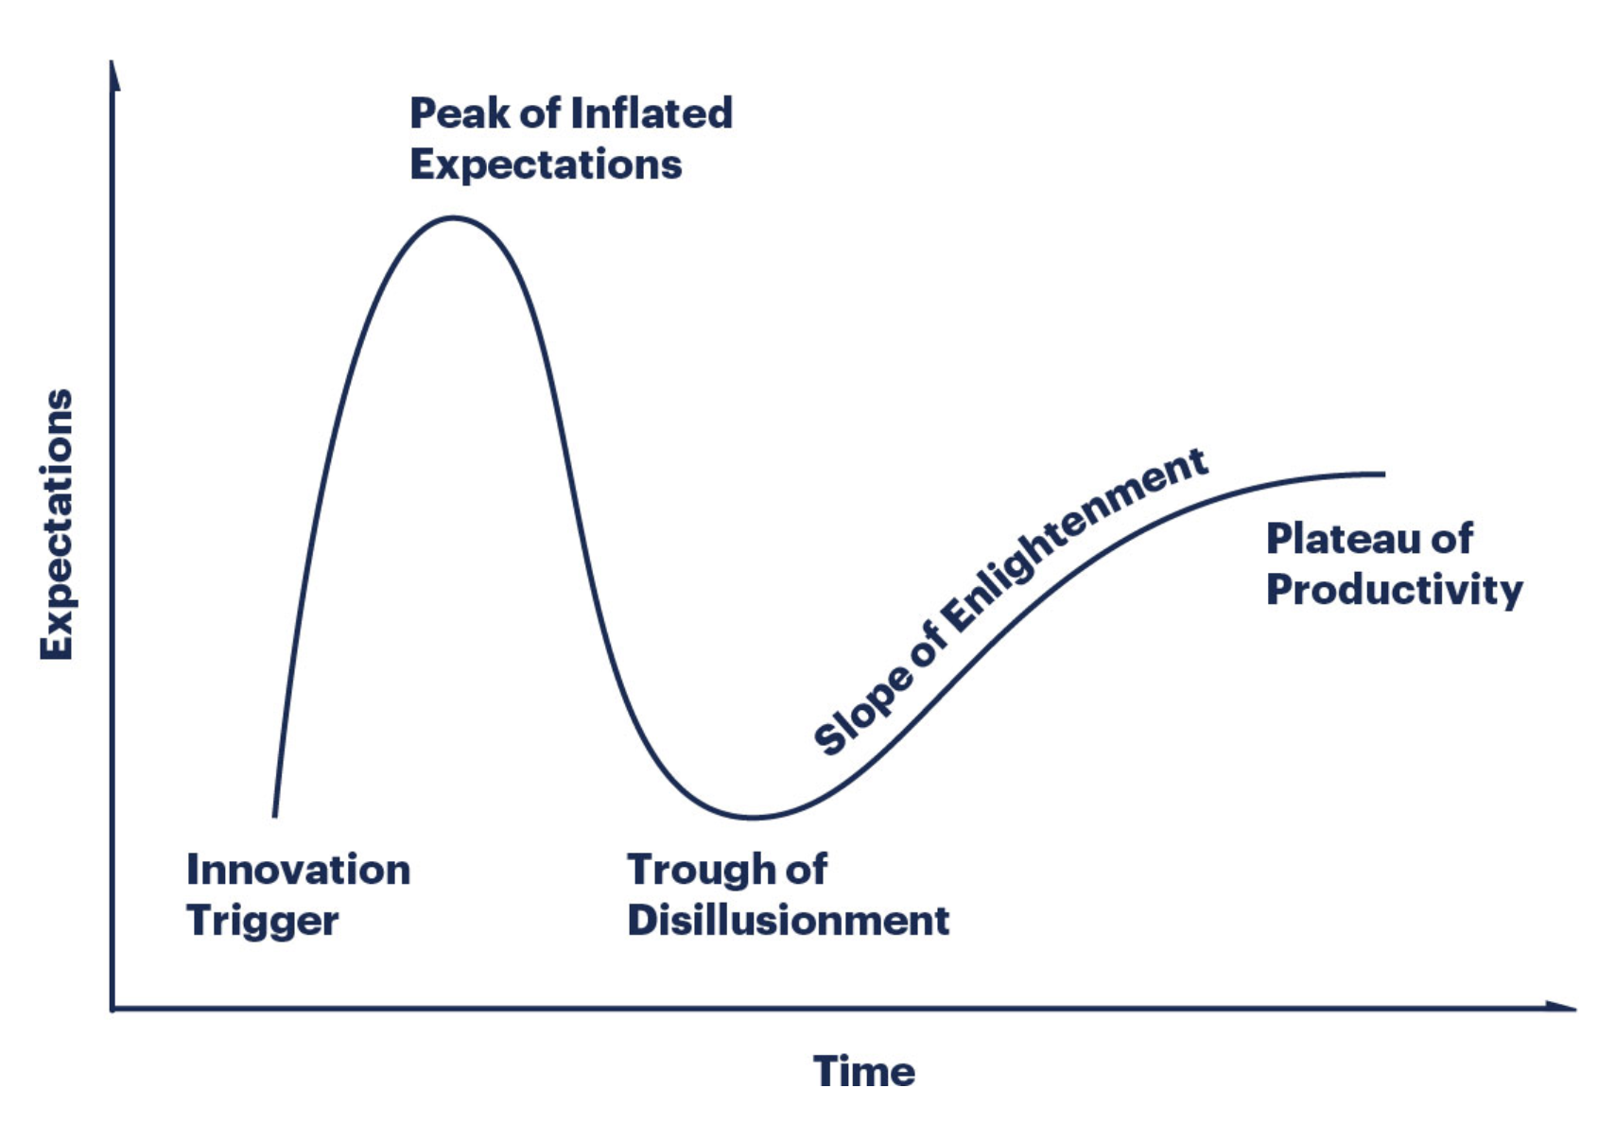
MIT IAP 2022: Navigating both commercial and defense markets
WHY STARTUPS SHOULD CONSIDER DEFENSE AS A BEACHHEAD MARKET
DoD can be a good partner with longer-term contracts once you get past the trough…
Q. So how do you get past the trough?
A. Understand your customer.
Gartner’s Hype Cycle |
https://www.gartner.com/en/research/methodologies/gartner-hype-cycle

Slide 10
GET TO KNOW YOUR CUSTOMER
MIT IAP 2022: Navigating both commercial and defense markets
We’ll discuss –
Army, Navy, Air Force, DoD writ large (e.g. OSD, DARPA, DLA, DHA, JPEOs, DTRA, and SOCOM)
We will not discuss –
USMC – usually piggybacks off other services projects
USCG – DHS, not DoD

Slide 11
GET TO KNOW YOUR CUSTOMER
MIT IAP 2022: Navigating both commercial and defense markets
Policymakers
End-users / Warfighters
Buyers / Acquisitions Professionals
Three primary stakeholders
These slides cover the top one
Buyers / Acquisitions Professionals

Slide 12
MIT IAP 2022: Navigating both commercial and defense markets
GET TO KNOW YOUR CUSTOMER
PEO
PM
PdM
PdM
PM
PdM
MDAP Portfolios
Programs or Projects
Products or Projects
Acronyms
MDAP = Major Defense Acquisition Program (POM’d; budgets appropriated by Congress)
PEO = Program Executive Office; run by SES or General Officer
PM = Program Manager; run by O6 or civilian equivalent
PdM = Product Manager; run by O5 or civilian equivalent
*These managers are selected and approved like their commander equivalents; “board selected” & given a “charter”

Slide 13
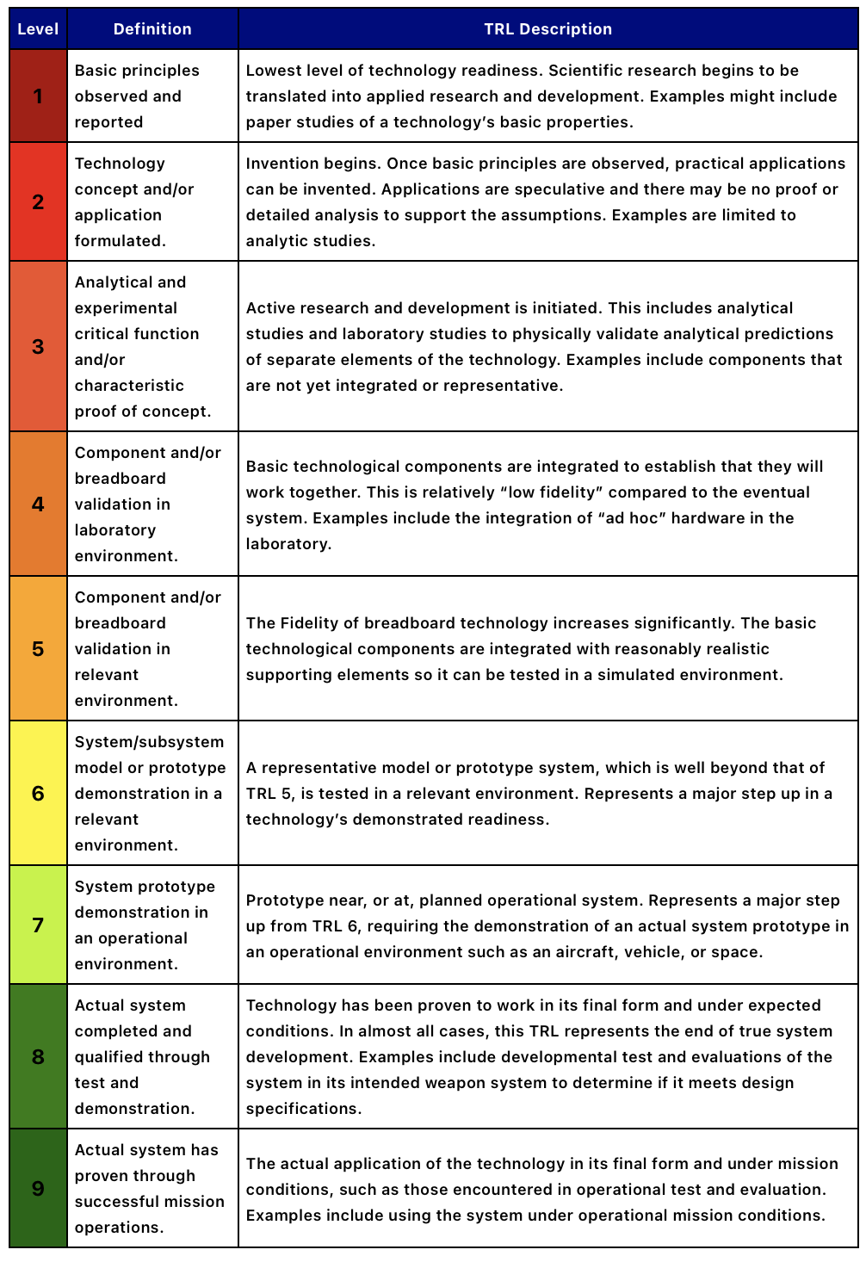
MIT IAP 2022: Navigating both commercial and defense markets
GET TO KNOW YOUR CUSTOMER
When DoD buys things, it often thinks in TRLs…
Technology Readiness Levels = TRLs
TRLs describe the maturity of a system or technology
TRLs run from 1 to 9, where 9 may be considered “Commercial-off-the-shelf”
DoD has a very specific definition for each TRL
Find the definitions and descriptions for each level here |
https://acqnotes.com/acqnote/tasks/technology-readiness-level

Slide 14
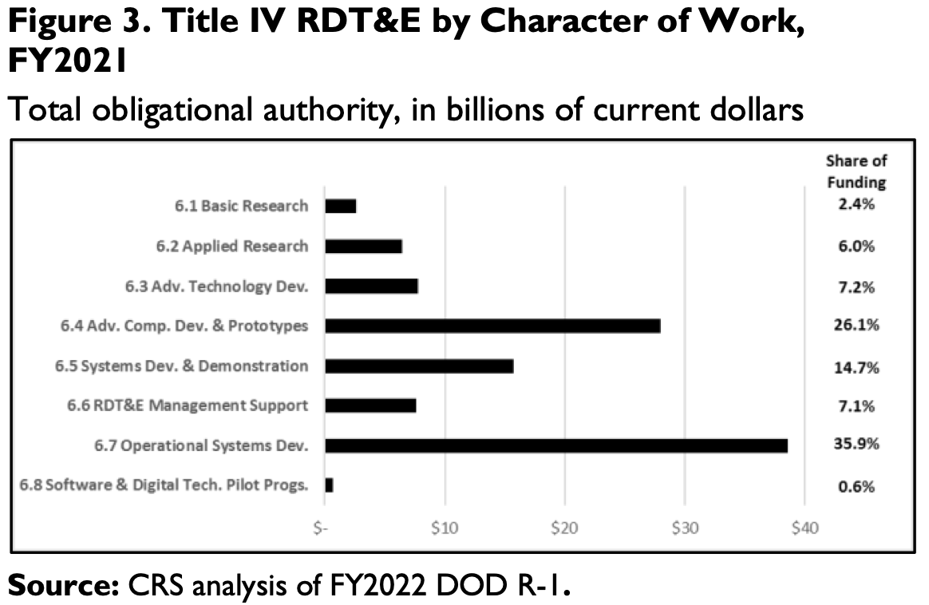
MIT IAP 2022: Navigating both commercial and defense markets
GET TO KNOW YOUR CUSTOMER
“Defense Primer: RDT&E.” Congressional Research Service (CRS). Updated October 21, 2021. https://crsreports.congress.gov/product/pdf/IF/IF10553.

Slide 15
MIT IAP 2022: Navigating both commercial and defense markets
GET TO KNOW YOUR CUSTOMER
1
2
3
4
5
6
7
8
9
TRL 2 – 4 | Army Research Lab | Naval Research Lab | Air Force Research Lab
TRL 4 – 6 | Army Futures Command, DEVCOM, CCDC | NAVSEA, NAVAIR, NUWCs, NSWCs, etc. | Air Force Research Lab
TRL 7 – 9 | Program Offices, PEOs, JPEOs, PMs, PdMs
Other | DLA | COTS | No requirement to be integrated into MDAP

Slide 16
MIT IAP 2022: Navigating both commercial and defense markets
GET TO KNOW YOUR CUSTOMER
TRL 7 – 9 | Gov Integrators |
PEOs are sub-organizations of ASA(ALT)
PEO Assembled Chemical Weapons Alternatives (ACWA)
PEO Aviation
PEO Command, Control, Communications-Tactical (C3T)
PEO Combat Support & Combat Service Support (CS & CSS)
PEO Enterprise Information Software (EIS)
PEO Ground Combat Systems (GCS)
PEO Intelligence, Electronic Warfare, & Sensors (IEW&S)
PEO Missiles & Space
PEO Soldier
PEO Simulation, Training, & Instrumentation (STRI)

Slide 17
MIT IAP 2022: Navigating both commercial and defense markets
GET TO KNOW YOUR CUSTOMER
TRL 4 – 6 | Gov Engineers |
CCDCs are sub-organizations of AFC
CCDC = US Army Combat Capabilities Development Command
DEVCOM Chemical & Biological Center
DEVCOM Aviation & Missile Center
DEVCOM C5ISR
DEVCOM Ground Vehicle Systems Center
DEVCOM Data & Analysis Center
DEVCOM Soldier Center
…and Army Research Lab…

Slide 18
MIT IAP 2022: Navigating both commercial and defense markets
GET TO KNOW YOUR CUSTOMER
1
2
3
4
5
6
7
8
9
Government scientists / engineer makes discovery for a specific army application | TRL 3 or 4 at the Army Research Lab (ARL)
...which feeds into the relevant CCDC Center…
TRL 4 – 6 | Government scientists / engineers mature the technology | AFC / CCDC / DEVCOM
…which feeds into the relevant PM…
TRL 7 – 9 | Government integrators / Program Managers | PEOs / PMs / PdMs
The DoD will engineer. It will not scale for production.
Therefore, tech startups are competing with internal capabilities unless you have something very novel.
ARL
CCDC
PM
To
PRIME CONTRACTOR
for production

Slide 19
RESOURCES & WHERE TO START
MIT IAP 2022: Navigating both commercial and defense markets
https://mitii.news/DuVToolbox

Slide 20
MIT IAP 2022: Navigating both commercial and defense markets
REGISTERING YOUR COMPANY
https://innovation.mit.edu/mission-innovation-program/mission-innovation-program_incubator/where-to-start-applying-to-the-dual-use-ventures-incubator/ overview of initial steps
http://www.dnb.com to obtain Duns & Bradstreet number
https://sam.gov/content/home to register your company with SAM
https://www.fedscout.com/registering-in-sam?hsLang=en tool to help you register in SAM
https://www.sbir.gov/registration to obtain SBC Control ID
https://www.dodsbirsttr.mil/submissions/login to register for DoD SBIRs and STTRs
https://www.sbir.gov/tutorials/registration-requirements/ SBIR registration tutorial
https://mitii.news/DuVToolbox

Slide 21
MIT IAP 2022: Navigating both commercial and defense markets
FINDING CONTRACT OPPORTUNITIES
https://sam.gov/content/home BAAs, SBIRs, STTRs, and all other competitive contracts, aggregated
https://www.dodsbirsttr.mil/submissions/login DoD SBIRs and STTRs, aggregated
https://afwerxchallenge.com collaboration which could result in SBIR
https://www.sofwerx.org prize competition
https://www.sbir.gov/sbirsearch/topic/current
https://aal.army competitions that use SBIR mechanism
https://www.arl.army.mil/xtechsearch/ prize competition
https://www.peosoldier.army.mil/sep/ idea generation
https://www.challenge.gov challenges
https://www.grants.gov grants (not contracts), Radiological, and Nuclear Defense
https://mitii.news/DuVToolbox

Slide 22
MIT IAP 2022: Navigating both commercial and defense markets
FINDING CONTRACT OPPORTUNITIES
https://www.diu.mil/work-with-us/commercial Defense Innovation Unit contracts
https://aida.mitre.org/ota/existing-ota-consortia/ consortia
https://www.health.mil/About-MHS/OASDHA/Defense-Health-Agency/Research-and-Development Defense Health Agency
https://mrdc.amedd.army.mil The Army’s Medical Research & Development Command
https://cdmrp.army.mil Congressionally-directed Medical Research Program
https://www.wrair.army.mil Walter Reed Army Institute of Research - Biomedical Research & Research Network
https://usaisr.amedd.army.mil US Army Institute of Surgical Research
https://techlinkcenter.org to license IP from the federal government & FFRDCs
https://mitii.news/DuVToolbox

Slide 23
MIT IAP 2022: Navigating both commercial and defense markets
FINDING CONTRACT OPPORTUNITIES
https://www.dtra.mil/Business/Office-of-Small-Business/ Defense Threat Reduction Agency
https://www.secnav.navy.mil/agility/Pages/guide_for_industry_academia.aspx NavalX
https://www.darpa.mil/work-with-us/opportunities DARPA
https://www.jpeocbrnd.osd.mil/Work-With-Us/ JPEO Chemical, Biological, Radiological, and Nuclear Defense
https://mitii.news/DuVToolbox

Slide 24
MIT IAP 2022: Navigating both commercial and defense markets
TYPES OF FEDERAL CONTRACTS
https://www.fedscout.com/the-different-types-of-government-contracts
https://aida.mitre.org/ota/ Other Transaction Authority (OTA)
https://aaf.dau.edu/aaf/contracting-cone/ Contracting Cone (distinguishes between FAR-based and OT contracts by nomenclature)
https://mitii.news/DuVToolbox

Slide 25
MIT IAP 2022: Navigating both commercial and defense markets
SBIR OVERVIEW
https://www.sbir.gov/about overview with a table of contents on the left hand side
https://www.sbir.gov/sites/default/files/elig_size_compliance_guide.pdf SBIR and STTR eligibility guide
https://www.sbir.gov/agencies-landing federal agencies that participate in the SBIR program
https://www.fedscout.com/a-startup-guide-to-sbir startup guide to SBIR
https://mitii.news/DuVToolbox

Slide 26
MIT IAP 2022: Navigating both commercial and defense markets
FAR, DFARS, DODI 5000
https://www.acquisition.gov/browse/index/far Federal Acquisition Regulation (FAR)
https://www.acquisition.gov/dfars Defense Federal Acquisition Regulation System (DFARS)
https://acqnotes.com/acquisition-index Index
https://acqnotes.com/references Acquisitions Regulations
https://www.safcn.af.mil/Organizations/CISO-Homepage/Small-Business-Cybersecurity-Information/ information for tech startups on a variety of cybersecurity compliance topics
https://www.sbir.gov/tutorials/cyber-security/ SBIR tutorial on cybersecurity for small business
https://www.fedramp.gov how to become FEDRAMP authorized
https://p1.dso.mil/ the platform one website
https://www.nist.gov/standards NIST standards
https://mitii.news/DuVToolbox

Slide 27
MIT IAP 2022: Navigating both commercial and defense markets
CYBERSECURITY & IT COMPLIANCE
https://www.safcn.af.mil/Organizations/CISO-Homepage/Small-Business-Cybersecurity-Information/ information for tech startups on a variety of cybersecurity compliance topics
https://www.sbir.gov/tutorials/cyber-security/ SBIR tutorial on cybersecurity for small business
https://www.fedramp.gov how to become FEDRAMP authorized
https://p1.dso.mil/ the platform one website
https://www.nist.gov/standards NIST standards
https://www.federalregister.gov/documents/2021/11/17/2021-24880/cybersecurity-maturity-model-certification-cmmc-20-updates-and-way-forward CMMC
https://www.acq.osd.mil/cmmc/ CMMC
https://mitii.news/DuVToolbox

Slide 28
MIT IAP 2022: Navigating both commercial and defense markets
CYBERSECURITY & IT COMPLIANCE
https://www.safcn.af.mil/Organizations/CISO-Homepage/Small-Business-Cybersecurity-Information/ information for tech startups on a variety of cybersecurity compliance topics
https://www.sbir.gov/tutorials/cyber-security/ SBIR tutorial on cybersecurity for small business
https://www.fedramp.gov how to become FEDRAMP authorized
https://p1.dso.mil/ the platform one website
https://www.nist.gov/standards NIST standards
https://www.federalregister.gov/documents/2021/11/17/2021-24880/cybersecurity-maturity-model-certification-cmmc-20-updates-and-way-forward CMMC
https://www.acq.osd.mil/cmmc/ CMMC
https://mitii.news/DuVToolbox

Slide 29
MIT IAP 2022: Navigating both commercial and defense markets
SBIR IP & DATA RIGHTS
https://www.fedscout.com/sbir-ip-for-founders SBIR awardee guide to IP
https://www.sbir.gov/tutorials/data-rights/tutorial-2 SBIR data rights
https://mitii.news/DuVToolbox

Slide 30
MIT IAP 2022: Navigating both commercial and defense markets
ITAR & EXPORTING
https://www.sbir.gov/tutorials/itar/ SBIR tutorial on ITAR
https://www.pmddtc.state.gov/ddtc_public State Department ITAR website
https://www.ecfr.gov/current/title-22/chapter-I/subchapter-M/part-121 CFR Munitions List
https://mitii.news/DuVToolbox

Slide 31
MIT IAP 2022: Navigating both commercial and defense markets
CFIUS & FIRRMA
https://home.treasury.gov/policy-issues/international/the-committee-on-foreign-investment-in-the-united-states-cfius CFIUS
https://www.congress.gov/bill/115th-congress/house-bill/4311 FIRRMA
https://mitii.news/DuVToolbox

Slide 32
MIT IAP 2022: Navigating both commercial and defense markets
VENTURE CAPITAL
https://innovation.mit.edu/education-community/blog/?topic=mission-driven-innovation Who’s Your Ally Blog Series
https://www.acq.osd.mil/tc/ Trusted Capital
https://dodtrustedcapital.force.com/s/ Trusted Capital Marketplace
https://www.wiley.law/assets/htmldocuments/2021-Gov-Con-SBIR-How-Acquisitions-and-Venture-Capital-Funding-Impact-Eligibility-for-SBIR-Awards.pdf VC and SBIR Eligibility
https://www.sba.gov/funding-programs/investment-capital SBICs
https://www.techstars.com investment with programming
https://www.engine.xyz investment with programming for tough tech
https://mitii.news/DuVToolbox

Slide 33
MIT IAP 2022: Navigating both commercial and defense markets
ACCELERATORS & PROGRAMMING
https://masschallenge.org non-profit accelerator (non-equity programming)
https://www.techstars.com investment with programming
https://www.engine.xyz investment with programming for tough tech
https://www.activate.org funded fellowship for tough tech
https://cyclotronroad.lbl.gov DOE accelerator
https://chainreaction.anl.gov DOE fellowship
https://www.fedtech.io programming
https://www.nsin.mil programming, National Security Innovation Network
https://icorps.mit.edu MIT I-Corps funded by the NSF
https://beta.nsf.gov/funding/opportunities/innovation-corps-teams-program NSF I-Corps national program
https://mitii.news/DuVToolbox

Slide 34
MIT IAP 2022: Navigating both commercial and defense markets
COST PROPOSAL & AUDITS
https://www.aptac-us.org/cost-proposals-government-contracts/ article
https://www.dcaa.mil/Small-Business/Small-Business-Resources/ DCAA small business resources
https://www.sbir.gov/tutorials/accounting-finance/tutorial-3 tutorial on developing indirect costs
https://www.sbir.gov/tutorials/accounting-finance/tutorial-4 tutorial on eligible and ineligible expenses
https://www.sbir.gov/tutorials/accounting-finance/ tutorial table of contents on the topic of accounting and finance
https://www.sbir.gov/sites/all/themes/sbir/dawnbreaker/img/documents/Course8-Tutorial2.pdf Timekeeping
https://mitii.news/DuVToolbox

Slide 35
MIT IAP 2022: Navigating both commercial and defense markets
AGGREGATED RESOURCES
https://www.sbir.gov/tutorials SBIR tutorials
https://www.fedscout.com/resources Fedscout resources
https://aida.mitre.org MITRE AiDA
https://www.dawnbreaker.com/resources/ Dawnbreaker resources
https://www.aptac-us.org PTAC Association
https://www.sba.gov/local-assistance/federal-contracting-assistance PTAC
https://www.score.org/us-small-business-administration-sba SCORE powered by the SBA
https://www.sba.gov SBA
https://mitii.news/DuVToolbox

Slide 36
TOUGH QUESTIONS
MIT IAP 2022: Navigating both commercial and defense markets
And abridged answers to start the conversation…
How do I go about finding a VC who will fund my startup? Which VCs are willing to fund tech startups with DoD contracts? Is it good, bad, or neutral that my company has a [Phase 1, Phase 2, OTA, etc.]?
I am not a US citizen. How can i do business with the US federal government?
I have software that needs to get ready to go on a .mil website. What are the steps?
What do these clauses in my contract about cybersecurity really mean? I work on AWS Gov Cloud, Google Cloud, etc. - does that suffice?
I need SIPR access to execute my contract, but my defense sponsor is in another state. Where can I access SIPR locally?

Slide 37
MIT IAP SERIES 2022
DUAL-USE VENTURES
Navigating both commercial and defense markets
JANUARY 19, 2022

