Slide 1

AN OFFERING IN THE BLUE CYBER SERIES:
Small Business Needs Big Cybersecurity
Version 14 Jan 2022
#9 in the Blue Cyber Education Series
Notes:
Photo source Photo by: Air Force photo | VIRIN: 201002-F-ZX772-001.JPG https://www.afnwc.af.mil/News/Photos/igphoto/2002520957/

Slide 2
Big Cybersecurity
The “Why” for Big Cybersecurity for Small Businesses
Execute the DFARS requirements
Report Cyber Incidents
Protect Controlled Unclassified Information(CUI) – and your Intellectual Property!
Implement NIST SP 800-171
Get your SPRS On!
Share CUI when you are ready to protect it
Get all the help available to the DIB Small Business community

Slide 3
The importance of Cybersecurity for Department of the Air Force Small Businesses
As small businesses drive innovation and support the Department of the Air Force (DAF) missions with cutting-edge technologies, it is vital we work together to protect DAF sensitive data and networks. Failure to protect our sensitive data will put service members and military missions at risk. We must match the aggressiveness of our cyber adversaries with radical teamwork to bring our small businesses up-to-speed in the most modern methods for comprehensive protection of DAF sensitive data and networks.
The DAF CISO Office Blue Cyber education series is the early partnership with the Defense Industrial Base (DIB) which enables small businesses to bake-in cybersecurity and move forward at the speed of innovation. Pairing small businesses with the most modern cyber protection methods in the industry, better positions DIB small businesses to protect sensitive information and networks just soon as they have a contract to innovate for the DAF. Small businesses are equally vulnerable to cyber threats and may have fewer resources than larger businesses with which to counter cyber threats. The key to protecting our DAF Airmen and Guardians in the exercise of their missions is getting an early start embracing our common cybersecurity and data protection goals by working together to create layered cyber defenses for the DIB small businesses.
This presentation will take you through the vital areas of cybersecurity collaboration for small businesses.

Slide 4
Federal Acquisition Regulation (FAR) and DFARS
Small Business contracts contains many FARS and DFARS, you must study them at length. These are not all of them, but these are some key security requirements.
What is a DFARS? The Defense Federal Acquisition Regulation Supplement (DFARS) contains requirements of law, DoD-wide policies, delegations of Federal Acquisition Regulation (FAR) authorities, deviations from FAR requirements, and policies/procedures that have a significant effect on the public.
DFARS Clause 252.239-7010
Cloud Computing Services
FAR Clause
252.204-21
Basic Safeguarding
of Covered
Contractor
Information Systems
DFARS Clause
252.204-7012, Safeguarding Covered Defense Information and Cyber Incident Reporting
DFARS Clause 252.204-7008 Compliance with safeguarding
covered defense information controls
DFARS Clause 252.204-7019/7020
NIST SP 800-171 DoD Assessment Requirements.
DFARS Clause
252.204-7021
Cybersecurity Maturity Model Certification Requirement

Slide 5
DFARS Clause 252.204-7021
Cybersecurity Maturity Model Certification Requirement
This DFARS is under review and it’s status will not be known until late 2022 at the earliest.
Until then, compliance with and full implementation of DFARS Clause 252.204-7012, “Safeguarding Covered Defense Information and Cyber Incident Reporting” is sufficient.
For more information on the new version of CMMC, see this great webinar by the DCMA Director John Ellis. https://www.preveil.com/resources/webinar-john-ellis-on-cmmc-2-0/
Stay up-to-date at www.acq.osd.mil/cmmc/
Notes:
https://www.acquisition.gov/dfars/252.204-7021-cybersecurity-maturity-model-certification-requirements.

Slide 6
DFARS Clause 252.239-7010 ― Cloud Computing Services
Applies when a cloud solution is being used to process data on the DoD's behalf or DoD is contracting with Cloud Service Provider to host/process data in a cloud
Ensures that the cloud service provider:
  Meets requirements of the DoD Cloud Computing Security Requirements Guide
  Use government-related data only to manage the operational environment that supports the Government data and for no other purpose
  Complies with requirements for cyber incident reporting and damage assessment
DFARS Clause 252.204-7012, Safeguarding Covered Defense Information and Cyber Incident Reporting, applies when a contractor intends to use an external cloud service provider to store, process, or transmit covered defense information in the performance of a contract. DFARS Clause 252.204-7012 requires the cloud service provider to meet security requirements equivalent to those established for the Federal Risk and Authorization Management Program (FedRAMP) Moderate baseline.
Notes:
https://www.acq.osd.mil/dpap/dars/dfars/html/current/252239.htm
Definition. “Cloud computing,” as used in this provision, means a model for enabling ubiquitous, convenient, on-demand network access to a shared pool of configurable computing resources (e.g., networks, servers, storage, applications, and services) that can be rapidly provisioned and released with minimal management effort or service provider interaction. This includes other commercial terms, such as on-demand self-service, broad network access, resource pooling, rapid elasticity, and measured service. It also includes commercial offerings for software-as-a-service, infrastructure-as-a-service, and platform-as-a-service.
Government-related data means any information, document, media, or machine readable material regardless of physical form or characteristics that is created or obtained by a contractor through the storage, processing, or communication of Government data. This does not include contractor's business records e.g. financial records, legal records etc. or data such as operating procedures, software coding or algorithms that are not uniquely applied to the Government data.
Government data means any information, document, media, or machine readable material regardless of physical form or characteristics, that is created or obtained by the Government in the course of official Government business.
FedRamp Moderate Baseline description https://www.fedramp.gov/assets/resources/documents/FedRAMP_Security_Controls_Baseline.xlsx
Question
Q99: Can you clarify when DFARS Clause 252.239-7010 applies to cloud computing services and when DFARS Clause 252.204-7012 applies?
A99: DFARS Clause 252.239-7010, Cloud Computing Services, applies when a cloud solution is being used to process data on the DoD's behalf, or DoD is contracting with a Cloud Service Provider to host or process data in a cloud. DFARS Clause 252.239-7010 requires the cloud service provider to comply with the DoD Cloud Computing Security Requirements Guide and to comply with requirements for cyber incident reporting and damage assessment.
DFARS Clause 252.204-7012, Safeguarding Covered Defense Information and Cyber Incident Reporting, applies when a contractor intends to use an external cloud service provider to store, process, or transmit covered defense information in the performance of a contract. DFARS Clause 252.204-7012 requires the cloud service provider to meet security requirements equivalent to those established for the Federal Risk and Authorization Management Program (FedRAMP) Moderate baseline.

Slide 7
FAR Clause 52.204-21 Basic Safeguarding of Covered Contractor Information Systems
Safeguarding requirements and procedures
(1) The Contractor shall apply the following basic safeguarding requirements and procedures to protect covered contractor information systems. Requirements and procedures for basic safeguarding of covered contractor information systems shall include, at a minimum, the following security controls:
- The FAR lists 15 security controls, which are considered basic cyber hygiene
(2) Other requirements. This clause does not relieve the Contractor of any other specific safeguarding requirements specified by Federal agencies and departments relating to covered contractor information systems generally or other Federal safeguarding requirements for controlled unclassified information (CUI) as established by Executive Order 13556.
Flow-down the requirement
The Contractor shall include the substance of this clause, including this paragraph (c), in subcontracts under this contract (including subcontracts for the acquisition of commercial items, other than commercially available off-the-shelf items), in which the subcontractor may have Federal contract information residing in or transiting through its information system.
Notes:
https://www.acquisition.gov/far/52.204-21-0

Slide 8

DFARS Clause 252.204-7012,
Safeguarding Covered Defense Information and Cyber Incident Reporting
Report cyber incidents
Submit malicious software
Facilitate damage assessment
Safeguard covered defense information
Notes:
https://business.defense.gov/Portals/57/Safeguarding%20Covered%20Defense%20Information%20-%20The%20Basics.pdf
https://www.acq.osd.mil/dpap/dars/dfars/html/current/252239.htm#252.239-7012

Slide 9
What if there is a potential breach?
Don’t panic. Cybersecurity occurs in a dynamic environment. Hackers are constantly coming up with new ways to attack information systems, and DoD is constantly responding to these threats. Even if a contractor does everything right and institutes the strongest checks and controls, it is possible that someone will come up with a new way to penetrate these measures. DoD does not penalize contractors acting in good faith. The key is to work in partnership with DoD so that new strategies can be developed to stay one step ahead of the hackers.
Contact DoD immediately. Bad news does not get any better with time. These attacks threaten America’s national security and put service members’ lives at risk. DoD has to respond quickly to change operational plans and to implement measures to respond to new threats and vulnerabilities. Contractors should report any potential breaches to DoD within 72 hours of discovery of any incident.
Be helpful and transparent. Contractors must also cooperate with DoD to respond to security incidents. Contractors should immediately preserve and protect all evidence and capture as much information about the incident as possible. They should review their networks to identify compromised computers, services, data and user accounts and identify specific covered defense information that may have been lost or compromised.
Questions? For more information, contact DoD OSBP at 571.372.6191
Notes:
https://business.defense.gov/Small-Business/Cybersecurity/

Slide 10
What to Report to the Federal Government
DHS Definition: A cyber incident is an event that could jeopardize the confidentiality, integrity, or availability of digital information or information systems.
DFARS 7012 Definition “Cyber incident” means actions taken through the use of computer networks that result in a compromise or an actual or potentially adverse effect on an information system and/or the information residing therein.
Report all cyber incidents that may:
  result in a significant loss of data, system availability, or control of systems;
  impact a large number of victims;
  indicate unauthorized access to, or malicious software present on, critical information technology systems;
  affect critical infrastructure or core government functions; or
  impact national security, economic security, or public health and safety.
Notes:
From https://www.dhs.gov/sites/default/files/publications/Cyber%20Incident%20Reporting%20United%20Message.pdf

Slide 11
Where to report cyber incidents/malware
To report cyber incidents that affect covered defense information Or that affect the contractor’s ability to perform requirements designated as operationally critical support, the Contractor shall conduct a review for evidence
of compromise and rapidly report cyber incidents to DoD at https://dibnet.dod.mil via an incident collection form (ICF).
If discovered and isolated in connection with a reported cyber incident,
the contractor/ subcontractor shall submit the malicious software to the
DoD Cyber Crime Center (DC3). Also, https://dibnet.dod.mil
If DoD elects to conduct a damage assessment, the Contracting Officer will
be notified by the requiring activity to request media and damage assessment information from the contractor
Notes:
“Malicious software” means computer software or firmware intended to perform an unauthorized process that will have adverse impact on the confidentiality, integrity, or availability of an information system. This definition includes a virus, worm, Trojan horse, or other code-based entity that infects a host, as well as spyware and some forms of adware.
“Media” means physical devices or writing surfaces including, but is not limited to, magnetic tapes, optical disks, magnetic disks, large-scale integration memory chips, and printouts onto which covered defense information is recorded, stored, or printed within a covered contractor information system

Slide 12
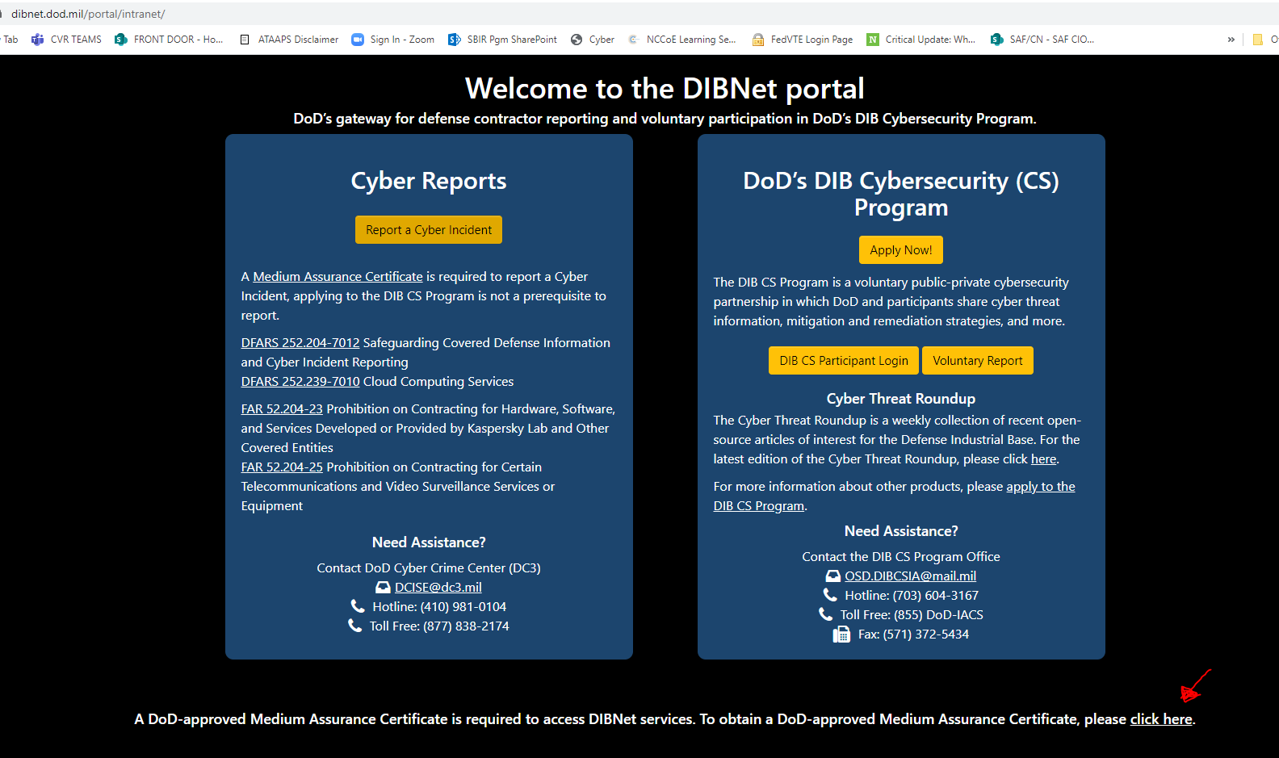
https://
dibnet.dod.mil
DISTRIBUTION C. Distribution authorized to U.S. Government Agencies and their contractors
Notes:
Red Arrow – it will take 72 hours to get the Medium Assurance Certificate – go ahead
DOD DIB CS is for contractors working with Classified contracts. An unclassified contractor pilot is underway – more news in January 2022

Slide 13
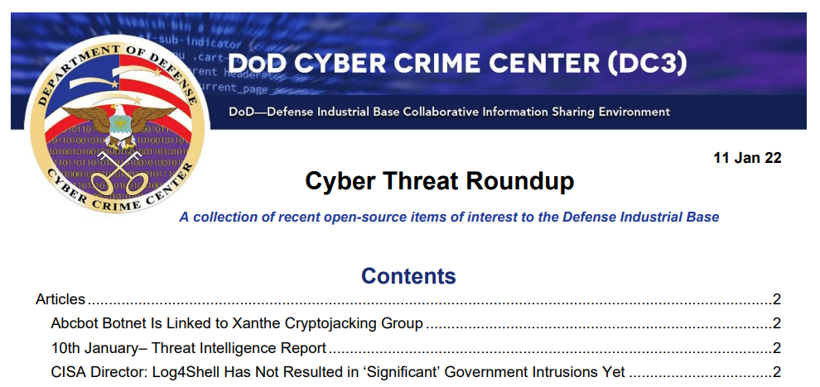
Notes:
https://dibnet.dod.mil/portal/rest/jcr/repository/collaboration/sites/intranet/web%20contents/site%20artifacts/public-content/Cyber%20Threat%20Roundup.pdf

Slide 14
Safeguard Covered Defense Information (CDI)
CDI is defined as unclassified controlled technical information (CTI) or other information as described in the DOD CUI Registry
AND it is marked as CUI
OR otherwise identified in the contract and provided to the contractor by DoD in support of performance of the contract;
OR collected/developed/received/transmitted/used/ stored by the contractor in performance of contract.
Notes:
https://business.defense.gov/Portals/57/Safeguarding%20Covered%20Defense%20Information%20-%20The%20Basics.pdf
www.dodcui.mil
Who is responsible for identifying and marking covered defense information? The DoD requiring activity is responsible for identifying covered defense information (CDI) in accordance with DoD procedures for identification and protection of controlled unclassified information found in DoDM 5200.01 Vol 4, DoD Information Security Program: Controlled Unclassified Information (CUI). The requiring activity is also responsible for determining the appropriate marking for the CDI in accordance with the procedures for applying distribution statements on technical documents found in DoDM 5200.01 Vol 4 and DoDI 5230.24, Distribution Statements on Technical Documents. The requiring activity must document in the Statement of Work that CDI is required for performance of the contract, and specify requirements for the contractor to mark the CDI developed in the performance of the contract

Slide 15
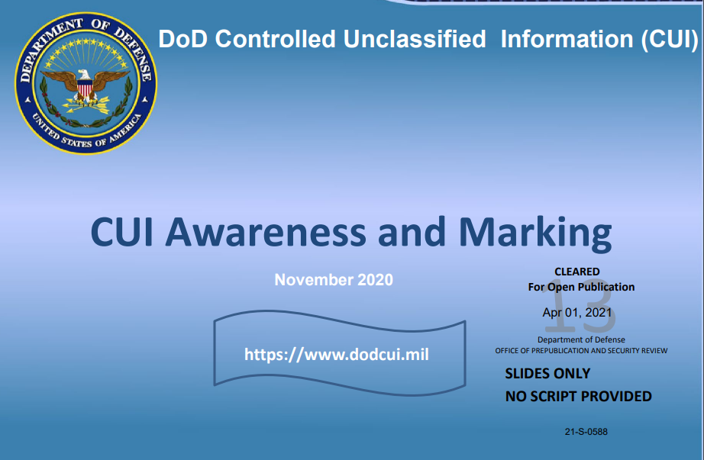
Safeguard CDI: What is CUI?
The DOD CUI Registry and detailed training on what constitutes CUI is available from the DOD at this link: https://www.dodcui.mil
Notes:
https://business.defense.gov/Portals/57/Safeguarding%20Covered%20Defense%20Information%20-%20The%20Basics.pdf
Who is responsible for identifying and marking covered defense information? The DoD requiring activity is responsible for identifying covered defense information (CDI) in accordance with DoD procedures for identification and protection of controlled unclassified information found in DoDM 5200.01 Vol 4, DoD Information Security Program: Controlled Unclassified Information (CUI). The requiring activity is also responsible for determining the appropriate marking for the CDI in accordance with the procedures for applying distribution statements on technical documents found in DoDM 5200.01 Vol 4 and DoDI 5230.24, Distribution Statements on Technical Documents. The requiring activity must document in the Statement of Work that CDI is required for performance of the contract, and specify requirements for the contractor to mark the CDI developed in the performance of the contract
CUI Training https://www.cdse.edu/documents/student-guides/IF141-guide.pdf
SUBJECT: Strategically Implementing Cybersecurity Contract Clauses https://www.acq.osd.mil/dpap/pdi/cyber/docs/USA000261-19%20USD%20Signed%20TAB%20A.pdf
HIPPA and PII

Slide 16
Safeguard CDI: What is CTI?
Controlled Technical Information (CTI) means technical information with military or space application that is subject to controls on the access, use, reproduction, modification, performance, display, release, disclosure, or dissemination.
Controlled technical information is to be marked.
The term does not include information that is lawfully publicly available without restrictions.
"Technical Information" means technical data or computer software, as those terms are defined in Defense Federal Acquisition Regulation Supplement clause 252.227-7013, "Rights in Technical Data - Noncommercial Items"
Examples of technical information include: research and engineering data, engineering drawings, and associated lists, specifications, standards, process sheets, manuals, technical reports, technical orders, catalog-item identifications, data sets, studies and analyses and related information, and computer software executable code and source code.
Notes:
https://business.defense.gov/Portals/57/Safeguarding%20Covered%20Defense%20Information%20-%20The%20Basics.pdf
Who is responsible for identifying and marking covered defense information? The DoD requiring activity is responsible for identifying covered defense information (CDI) in accordance with DoD procedures for identification and protection of controlled unclassified information found in DoDM 5200.01 Vol 4, DoD Information Security Program: Controlled Unclassified Information (CUI). The requiring activity is also responsible for determining the appropriate marking for the CDI in accordance with the procedures for applying distribution statements on technical documents found in DoDM 5200.01 Vol 4 and DoDI 5230.24, Distribution Statements on Technical Documents. The requiring activity must document in the Statement of Work that CDI is required for performance of the contract, and specify requirements for the contractor to mark the CDI developed in the performance of the contract
https://www.archives.gov/cui/registry/category-detail/controlled-technical-info.html
Controlled Technical Information means technical information with military or space application that is subject to controls on the access, use, reproduction, modification, performance, display, release, disclosure, or dissemination. Controlled technical information is to be marked with one of the distribution statements B through F, in accordance with Department of Defense Instruction 5230.24, "Distribution Statements of Technical Documents." The term does not include information that is lawfully publicly available without restrictions. "Technical Information" means technical data or computer software, as those terms are defined in Defense Federal Acquisition Regulation Supplement clause 252.227-7013, "Rights in Technical Data - Noncommercial Items" (48 CFR 252.227-7013). Examples of technical information include research and engineering data, engineering drawings, and associated lists, specifications, standards, process sheets, manuals, technical reports, technical orders, catalog-item identifications, data sets, studies and analyses and related information, and computer software executable code and source code.

Slide 17
Implementation of NIST SP 800-171
Implementation of the NIST SP 800-171 involves implementing and documenting the 110 security requirements listed in the document.
  The implementation of security requirements is recorded in a System Security Plan (NIST SP 800-171 security requirement 3.12.4) and
  Any un-implemented security requirement and it’s interim plan to provide alternative, but equally effective, security measure is recorded in a Plan of Action with Milestones, called a POAM (NIST SP 800-171 security requirement 3.13.2)
Help with understanding the NIST SP 800-171 security requirements is found at this link: https://nvlpubs.nist.gov/nistpubs/hb/2017/NIST.HB.162.pdf
Notes:
https://www.acq.osd.mil/dpap/dars/dfars/html/current/252239.htm#252.239-7012
“Malicious software” means computer software or firmware intended to perform an unauthorized process that will have adverse impact on the confidentiality, integrity, or availability of an information system. This definition includes a virus, worm, Trojan horse, or other code-based entity that infects a host, as well as spyware and some forms of adware.
“Media” means physical devices or writing surfaces including, but is not limited to, magnetic tapes, optical disks, magnetic disks, large-scale integration memory chips, and printouts onto which covered defense information is recorded, stored, or printed within a covered contractor information system
At this link you will find NIST CUI SSP Template and a guide to help you – just go through it https://csrc.nist.gov/publications/detail/sp/800-171a/final
- If the offeror proposes to vary from NIST SP 800-171, they shall submit to the CO a written explanation of why a security requirement is not applicable OR how an alternative security measure is used to achieve equivalent protection

Slide 18
DFARS Clause 252.204-7008 Compliance with safeguarding
covered defense information controls
States “By submission of this offer, the Offeror represents that it will implement the security requirements specified by NIST SP 800-171, … not later than December 31, 2017.
If the Offeror proposes to vary from any of the security requirements specified by NIST SP 800-171 …, the Offeror shall submit to the Contracting Officer, for consideration by the DoD Chief Information Officer (CIO), a written explanation of:
  Why a particular security requirement is not applicable
  How an alternative but equally effective, security measure is used to compensate for the inability to satisfy a particular requirement and achieve equivalent protection.
  An authorized representative of the DoD CIO will adjudicate offeror requests to vary from NIST SP 800-171 requirements in writing prior to contract award. Any accepted variance from NIST SP 800-171 shall be incorporated into the resulting contract.
Notes:
https://www.law.cornell.edu/cfr/text/48/252.204-7008

Slide 19
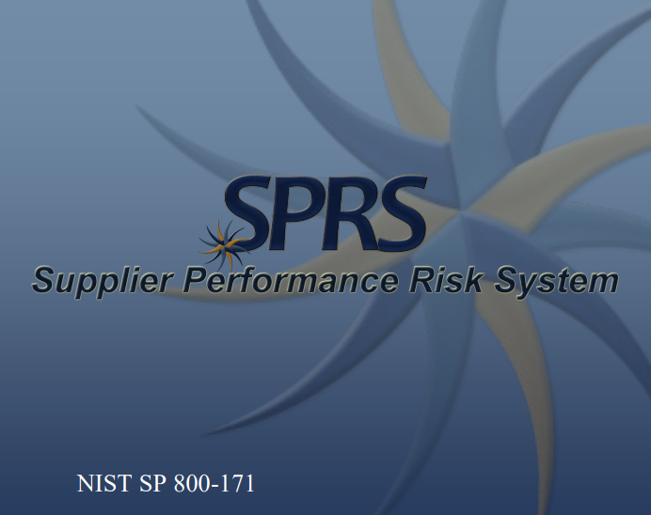
DFARS Clause 252.204-7019/7020
NIST SP 800-171 DoD Assessment Requirements.
Self-Assessment
photo
Submit information to SPRS.CSD.DISA.MIL
Flow the Requirement Down
Update your Self-Assessment
Notes:
https://business.defense.gov/Portals/57/Safeguarding%20Covered%20Defense%20Information%20-%20The%20Basics.pdf

Slide 20
The Requirement in DFARS Clause 252.204-7019/7020
NIST SP 800-171 DoD Assessment Requirements
In order to be considered for award, if the Offeror is required to implement NIST SP 800-171, the Offeror shall have a current assessment for each covered contractor information system that is relevant to the contract.
A Basic Assessment, which is a self-assessment assigned a low confidence level (because it is self-generated) is:
  Based on the Contractor’s review of their system security plan(s) associated with covered contractor information system(s)
  Conducted in accordance with the NIST SP 800-171 DoD Assessment Methodology

Slide 21
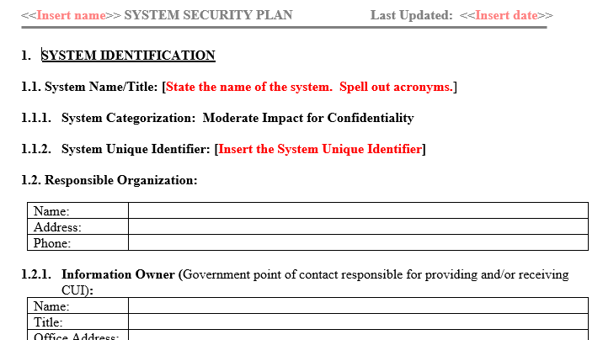
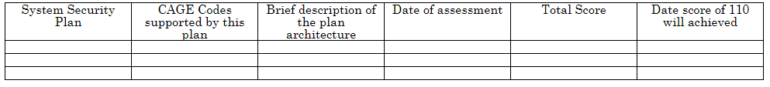
NIST SP 800-171 System Security Plan (SSP)
Optional Template available on NIST.Gov
Optional Template to record the Plan of Action on NIST.gov

Slide 22
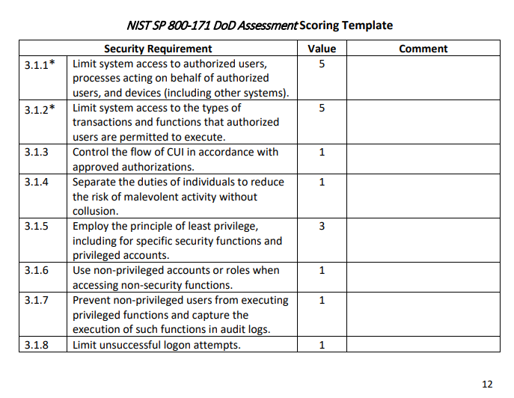
Not all of the NIST SP 800-171 security requirements are equal
The NIST SP 800-171 DoD Assessment Methodology identifies 42 security requirements that, if not implemented, could lead to significant exploitation of the network, or exfiltration of DoD CUI.
These high-risk security requirements are with 5 points in the DoD scoring rubric.
For example, Failure to limit system access to authorized users (Requirement 3.1.1) renders all the other Access Control requirements ineffective, allowing easy exploitation of the network
For example, Failure to control the use of removable media on system components (Requirement 3.8.7) could result in massive exfiltration of CUI and introduction of malware.
Notes:
NIST SP 800-171 DoD Assessment Methodology Link https://www.acq.osd.mil/dpap/pdi/cyber/docs/NIST%20SP%20800-171%20Assessment%20Methodology%20Version%201.2.1%20%206.24.2020.pdf

Slide 23
Safeguard Covered Defense Information (CDI)
To safeguard covered defense information contractors/subcontractors must implement NIST SP 800-171, Protecting CUI in Nonfederal Information Systems and Organizations
The covered contractor information system shall be subject to the security requirements in National Institute of Standards and Technology (NIST) Special Publication (SP) 800-171
  The Contractor shall implement NIST SP 800-171, as soon as practical, but not later than December 31, 2017.
  The Contractor shall submit requests to vary from NIST SP 800-171 in writing to the Contracting Officer, for consideration by the DoD CIO
Notes:
https://www.acquisition.gov/dfars/252.204-7020-nist-sp-800-171-dod-assessment-requirements.
Will the DoD monitor contractors to ensure implementation of the required security requirements?
The DFARS rule does not add any unique/additional requirements for the DoD to monitor contractor implementation. Nor does the rule require “certification” of any kind, either by DoD or any other firm professing to provide compliance, assessment, or certification services for DoD or Federal contractors. The DoD will not recognize 3rd party assessments or certifications. By signing the contract, the contractor agrees to comply with the terms of the contract. The contractor’s system security plan (SSP) – required by NIST SP 800-171 - documents how the organization meets, or plans to meet, the NIST SP 800-171 requirements. When requested by the requiring activity, the SSP (or elements of the SSP) may be used to demonstrate implementation of NIST SP 800-171 or to inform a discussion of risk between the contractor and requiring activity.
https://business.defense.gov/Portals/57/Safeguarding%20Covered%20Defense%20Information%20-%20The%20Basics.pdf

Slide 24
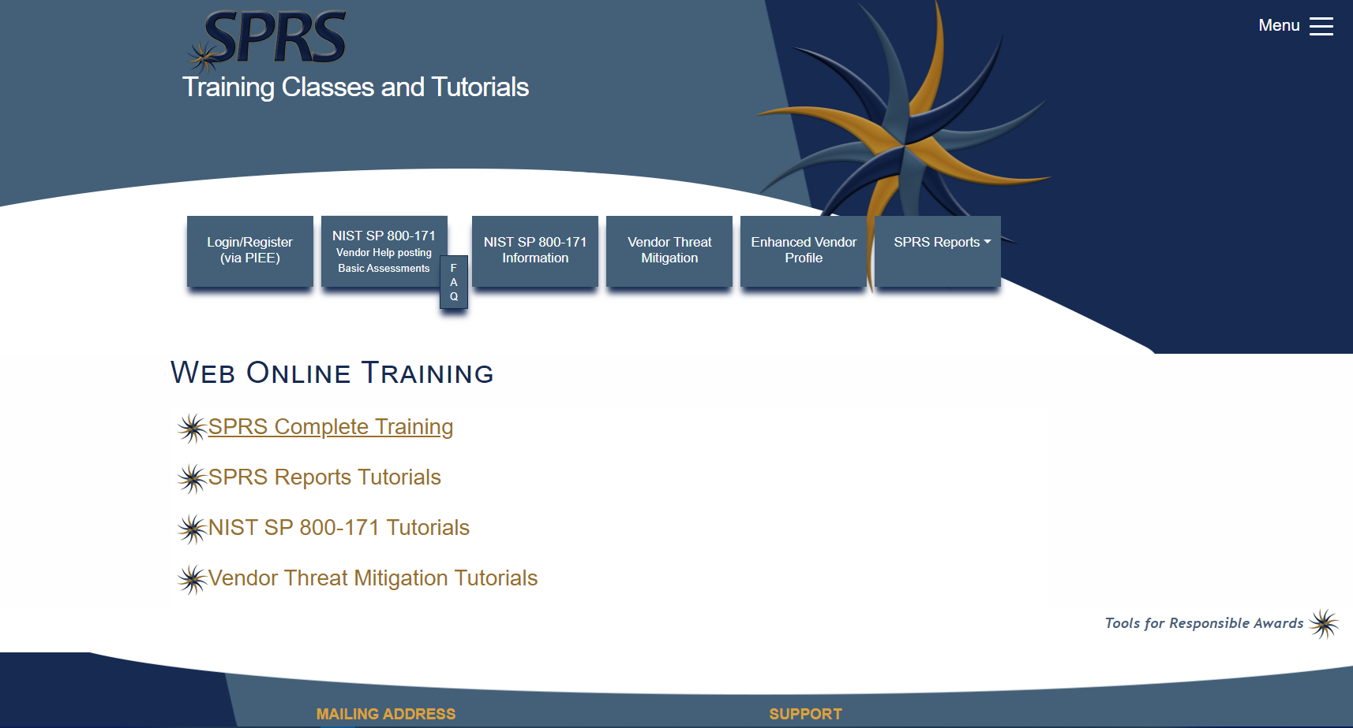
How to enter a Basic Assessment Data into SPRS
Post or email your business’ summary level scores of a current NIST SP 800-171 DoD Assessment to SPRS for all covered contractor information systems relevant to the contract.
Your entry consists of
  A system security plan (NIST SP 800-171 item 3.12.4) supporting the performance of a DoD contract—)
  Summary level score (e.g., 95 out of 110, NOT the individual value for each requirement) using the NIST SP 800-171 DoD Assessment Methodology
  Date that all requirements are expected to be implemented (i.e., a score of 110 is expected to be achieved) based on information gathered from associated plan(s) of action developed in accordance with NIST SP 800-171
The SPRS website offers numerous training videos which will help you get an account and make your entry
Notes:
Image source from https://www.sprs.csd.disa.mil

Slide 25
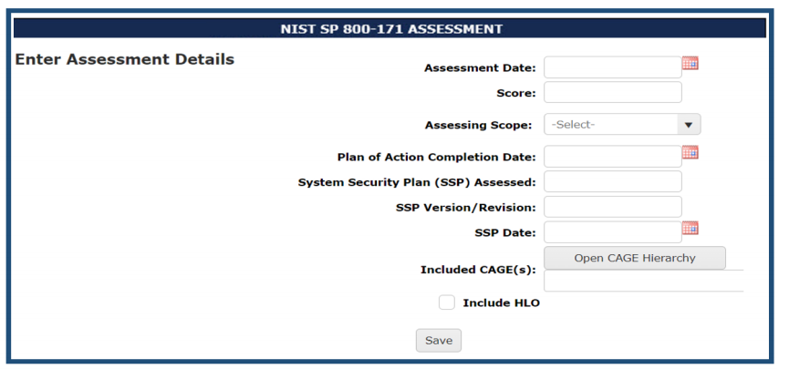
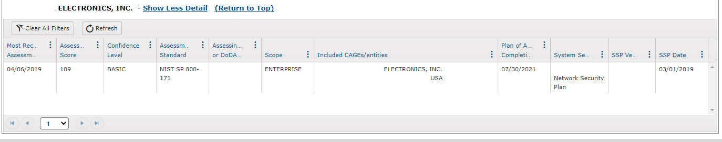
How to enter a Basic Assessment Data into SPRS
SPRS Basic Assessment data entry fields
Example output
of SPRS Basic Assessment

Slide 26
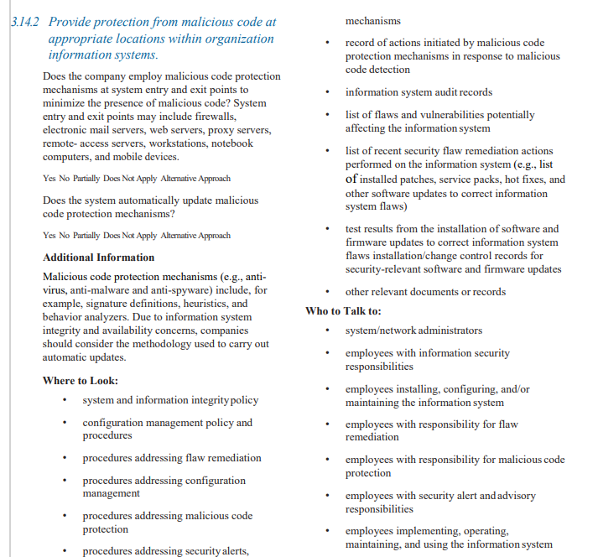
You Have Help with the NIST MEP Handbook
NIST Manufacturing Extension Partnership (MEP) Handbook will walk you through all 110 requirements and provide a list of process and policy documents you would create to have a robust CUI protection program
Notes:
Link https://nvlpubs.nist.gov/nistpubs/hb/2017/NIST.HB.162.pdf

Slide 27
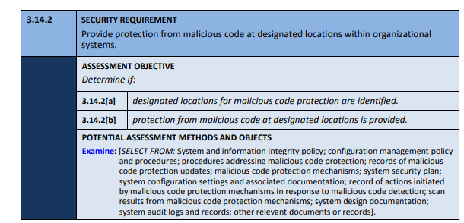
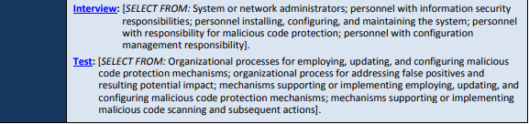
You Have Help with NIST SP 800-171A, Assessing Security Requirements for CUI
  The NIST SP 800-171A provides nonfederal organizations with assessment procedures and a methodology that can be employed to conduct assessments of the CUI security requirements.
  The assessment procedures are flexible and can be customized to the needs of the organizations and the assessors conducting the assessments.
Notes:
Link https://nvlpubs.nist.gov/nistpubs/hb/2017/NIST.HB.162.pdf

Slide 28
Why NIST SP 800-171 - Protecting CUI in Nonfederal Information Systems and Organizations?
The NIST SP 800-171 was written using performance-based security requirements to enable contractors to use systems and practices they already have in place to process, store, or transmit CUI.
  It eliminates unnecessary specificity and includes only those security requirements necessary to provide adequate protection.
  Though most requirements in NIST SP 800-171 are about policy, process, and configuring IT securely, some require security-related software or additional hardware.
Notes:
https://business.defense.gov/Portals/57/Safeguarding%20Covered%20Defense%20Information%20-%20The%20Basics.pdf

Slide 29
Can I give my contractor CUI?
DFARS 7012 “Adequate Security” quote red added for emphasis
… (b) Adequate security. The Contractor shall provide adequate security on all covered contractor information systems. To provide adequate security, the Contractor shall implement, at a minimum, the following information security protections:
…
(1) For covered contractor information systems that are part of an Information Technology (IT) service or system operated on behalf of the Government, the following security requirements apply:
(i) Except as provided in paragraph (b)(2)(ii) of this clause, the covered contractor information system shall be subject to the security requirements in National Institute of Standards and Technology (NIST) Special Publication (SP) 800-171, “Protecting Controlled Unclassified Information in Nonfederal Information Systems and Organizations” in effect at the time the solicitation is issued or as authorized by the Contracting Officer.
(ii)(A) The Contractor shall implement NIST SP 800-171, as soon as practical, but not later than December 31, 2017. …
Notes:
https://www.acq.osd.mil/dpap/dars/dfars/html/current/252204.htm#252.204-7012
https://www.acq.osd.mil/dpap/dars/dfars/html/current/252204.htm#252.204-7020 = DFARS 7020 NIST SP 800-171 DOD ASSESSMENT REQUIREMENTS
https://www.acq.osd.mil/dpap/pdi/cyber/docs/NIST%20SP%20800-171%20Assessment%20Methodology%20Version%201.2%20%206.24.2020.pdf

Slide 30
Answer today: Can I give my contractor CUI? You need to ask.
Yes, if:
The decision to share CUI is a risk-based decision based upon a conversation with the contractor regarding if they are ready to provide adequate protection to DoD CUI.
There is not a cut and dried answer rubric.
CUI protection is a shared responsibility between the DoD and industry.
Adequate security will vary depending on the nature and sensitivity of the information on any given non-DoD information system.
See DFARS 252.204-7012 “Safeguarding Covered Defense Information and Cyber Incident Reporting, December 2019,” “Section b”, for a description of “Adequate Security”
If you need help with this decision, please contact your Program or Wing cybersecurity office. Also, Kelley Kiernan from the DAF CISO Office is available to talk with you. Keep your contracting officer informed of your activities.
This question is being studied across the DOD – check back for an updated answer

Slide 31
Discuss with the contractor their readiness to provide adequate protection for DOD CUI
Risk-Based Decision Questions
Review the contractor’s System Security Plan and associated POAM
  Are all 42, 5-point weighted security requirements implemented with no POAM?
  Are all 14, 3-point weighted security requirements implemented with no POAM?
Is the CUI that the DAF is considering sharing with the contractor in a sensitive category such as these categories? NOFORN, FED ONLY, NOCON, DL ONLY, REL TO [USA, LIST], DISPLAY ONLY, Attorney-Client, Attorney-WP or otherwise sensitive?
Is the CUI that the DAF is considering sharing with the contractor mission-essential?
Is the CUI the DAF is considering sharing with the contractor appropriate for research?
Have you rejected the use of synthetic data in this contract?
Apply these questions to contractor-created CUI and the government-provided CUI

Slide 32
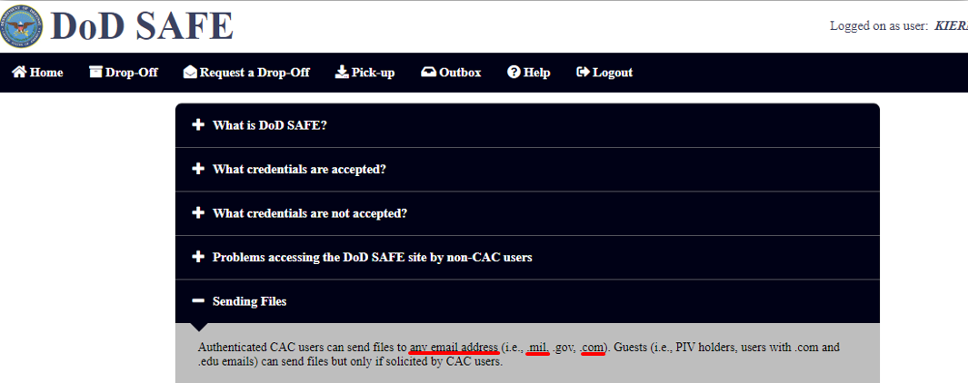
DOD SAFE creates potential exposure
DOD Safe will let a CAC-holder send CUI to any email address. You must ask contractors if they are ready to provide adequate protection to any CUI sent via DOD SAFE and be satisfied with the answer you receive.
Contractors who are not ready to protect CUI should not accept CUI
Notes:
https://safe.apps.mil/

Slide 33
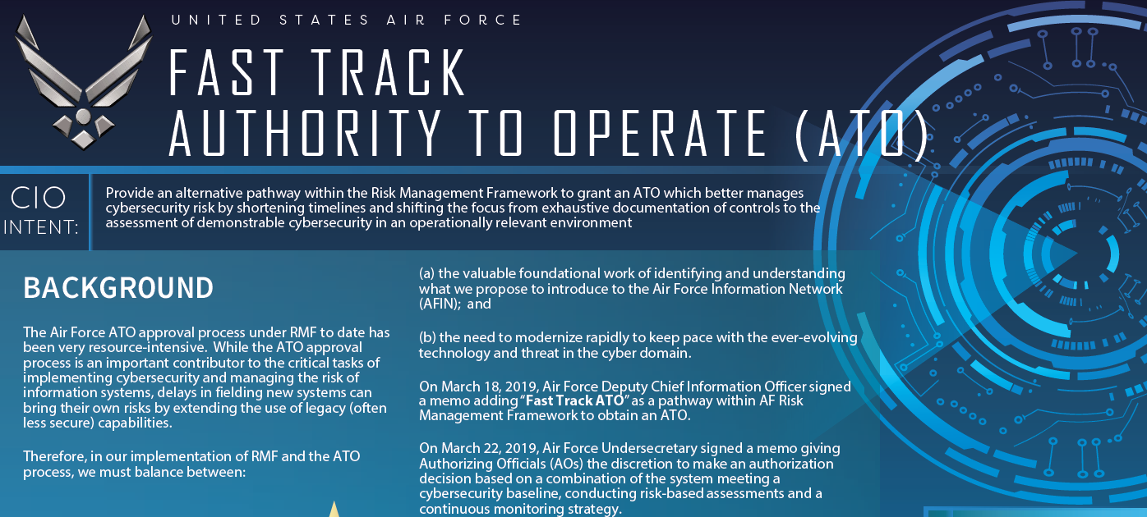
The Fast Track Authorization to Operate (ATO) allows the AO to make an authorization decision based on the review of
a Cybersecurity Baseline,
a Threat-Risk Assessment (e.g. penetration test), and
an Information System Continuous Monitoring Strategy.
Notes:
Fast Track Slick Sheet: https://rmfks.osd.mil/rmf/Collaboration/Component%20Workspaces/AirForce/Air%20Force%20Shared%20Document%20Library/Base/Fast%20Track%20ATO/CISO%20Fast%20Track%20Slick%20Sheet%2020200915.pdf

Slide 34
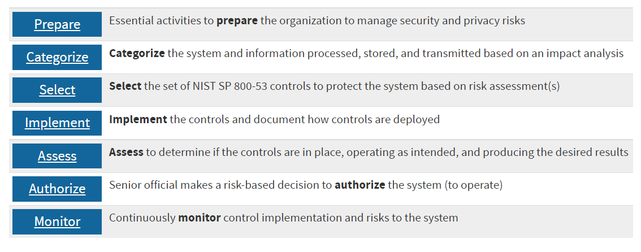
RMF Steps
Fast Track accelerates RMF steps “Select” through “Authorize” by focusing on operationally relevant risk identification, and ensuring threat-informed risk assessments for DAF systems and missions. The objective being the integration of the Acquisition, Test, and Operations communities in assessing and determining system and mission risk to better inform mission owners.
Additionally, Fast Track ATO is for managing risk for the life-cycle of a system; not a one and done. The job does not end when the ATO is issued, it only begins…
Notes:
https://csrc.nist.gov/projects/risk-management/about-rmf

Slide 35
What is an Authorization to Operate?
An ATO is the official management decision given by a senior organizational official to authorize operation of an information system and to explicitly accept the risk to organizational operations (including mission, functions, image, or reputation), organizational assets, individuals, other organizations, and the Nation based on the implementation of an agreed-upon set of security controls.
ATOs often have conditions and assumptions, which must be continuously monitored by the Program Office which applied for the ATO.
Notes:
https://static.e-publishing.af.mil/production/1/saf_cn/publication/afi17-101/afi17-101.pdf
Fast Track demonstrates the cyber risk management process can be based on solid foundational systems engineering, by treating cyber risks equal to other program risks.
Fast Track outlines the requirements and testing methodology to move toward operationally informed risk management.

Slide 36
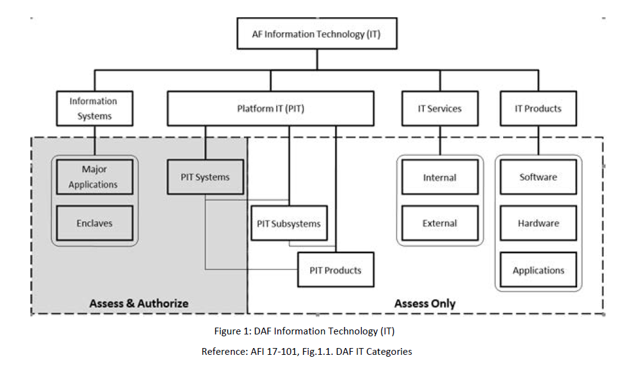
Do I need an ATO?
Maybe not…
If the Program is proposing an internal or external IS service, such as a web-based application or SaaS, the AO will decide
IT below the system level (Single Purpose IT Products or Devices, PIT Subsystems, PIT Products, IT Products, and IT Services) or if the IS in an internal or external IS service, the AO has discretion to simply approve for use.
Notes:
https://static.e-publishing.af.mil/production/1/saf_cn/publication/afi17-101/afi17-101.pdf
DAF DRAFT “ASSESS –ONLY PROCESS GUIDE, V 3.0 22 JUN 2021
Platform Information Technology (PIT)—Information technology (IT), both hardware and software, that is physically part of, dedicated to, or essential in real time to the mission performance of special purpose systems. PIT Product—Individual hardware or software components, including, but not limited to, operating systems, commercial or government software, or individual hardware that support specific mission functionality. IT Products, when purposed for PIT, become PIT Products. PIT Subsystem—A collection of PIT that does not rise to the level of a PIT system. PIT System—A collection of PIT within an identified boundary under the control of a single authority and security policy. The systems may be structured by physical proximity or by function, independent of location.

Slide 37
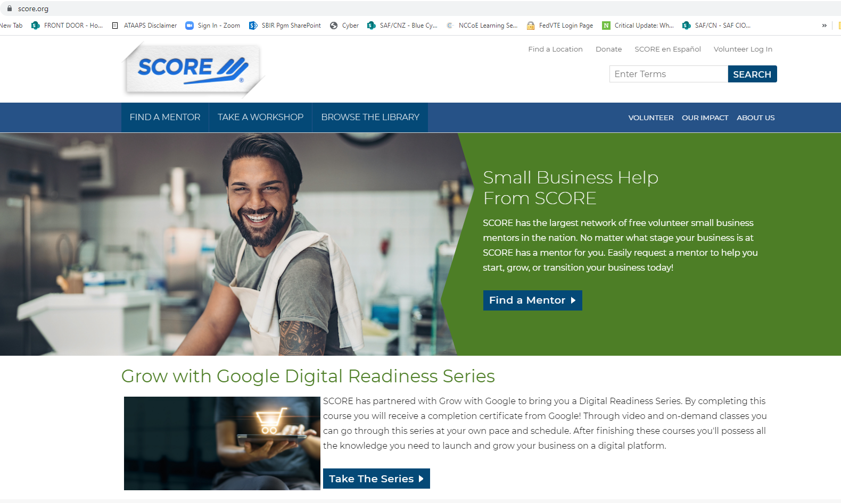
SBIR/STTR Firms!
Notes:
www.score.org

Slide 38
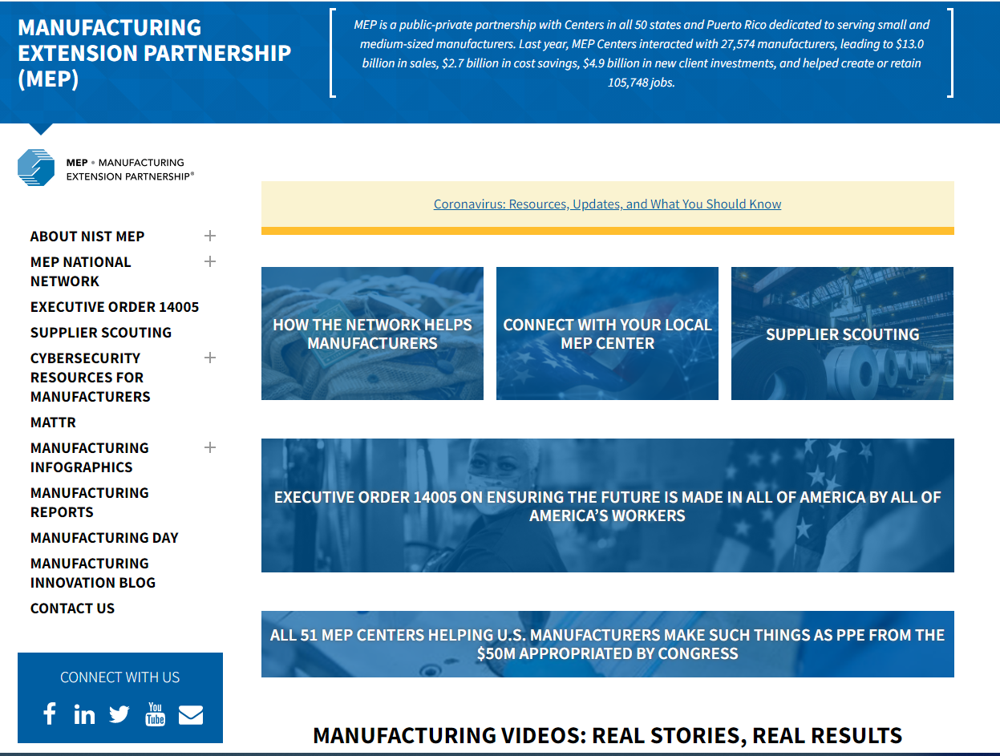
www.nist.gov/mep
Notes:
www.nist.gov/mep

Slide 39
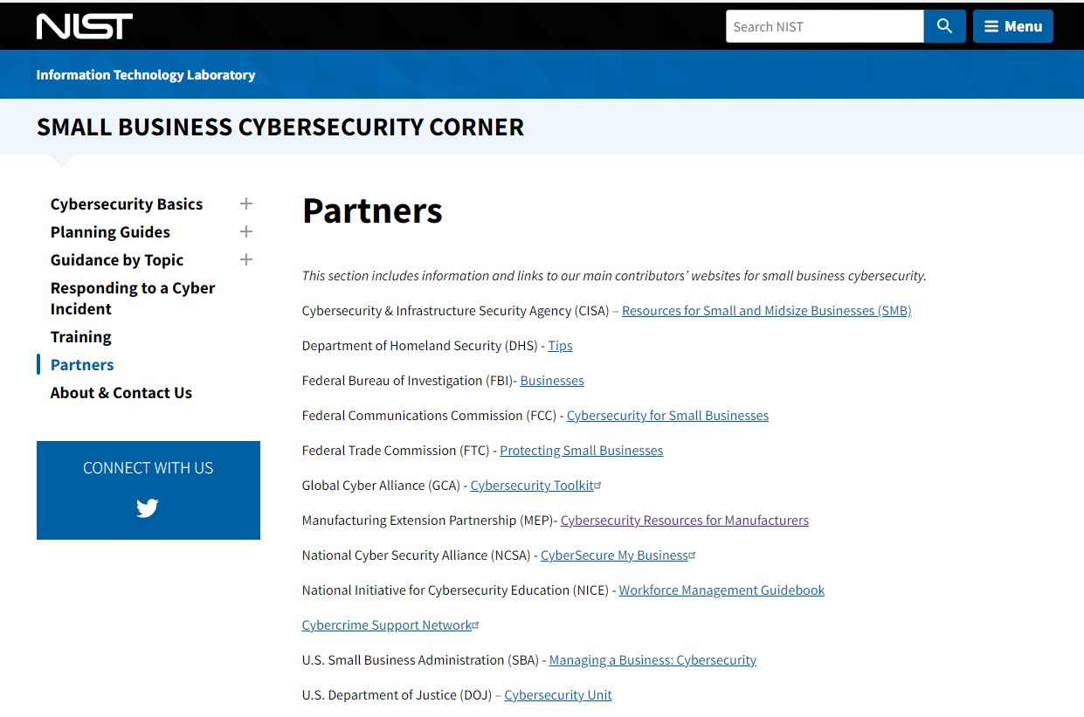

Slide 40
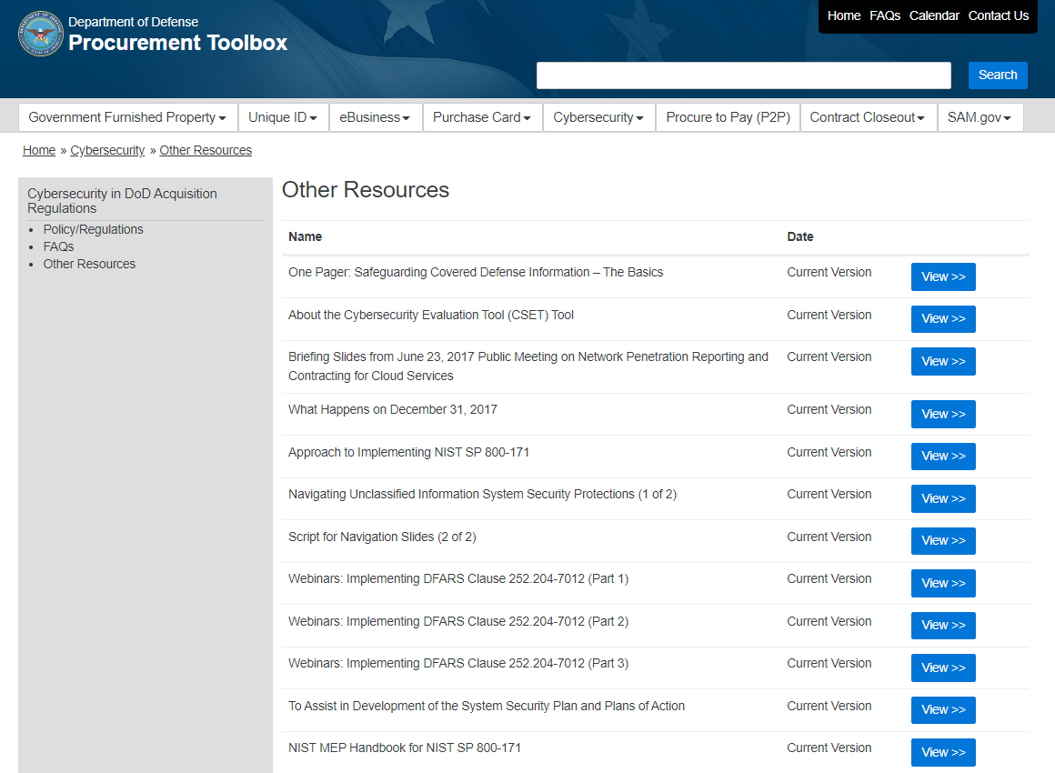
Notes:
https://dodprocurementtoolbox.com/site-pages/cybersecurity-other-resources

Slide 41
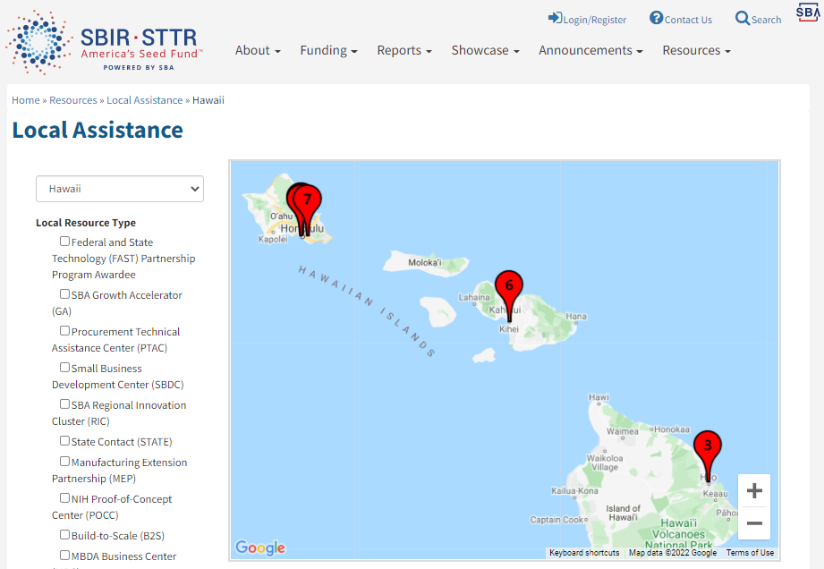
www.sbir.gov/local-assistance
Notes:
www.sbir.gov/local-assistance
www.dla.mil/SmallBusiness/PTAP/
https://business.defense.gov/Portals/57/Documents/Webcast%20%20PTAP.pdf?ver=N89R8wNm7TU%3d
What PTACs Provide at No Cost: • Training related to contracts with DoD, other federal agencies, state and local govts • Identify prime & subcontracting opportunities • Prime-specific subcontractor training • Understanding procedures, requirements, rules, statutes, clauses and regulations • Registrations: SAM, DSBS, DLA’s DIBBS, WAWF etc. • Preparing and submit
A Government Partner • Knowledge of local small business communities and their capabilities for effective market research • Collaborate with government for outreach to industry • Refer a business for one-on-one assistance • Team for specific assistance, e.g., matchmaking events for certain commodities or procurements, agency-specific requirements training, pre-solicitation conferences, pitch days, identify and train subcontractor sing bids & proposals • Assist with cybersecurity self-assessment and CMMC • Facilitate introductions, collaboration opportunities

Slide 42
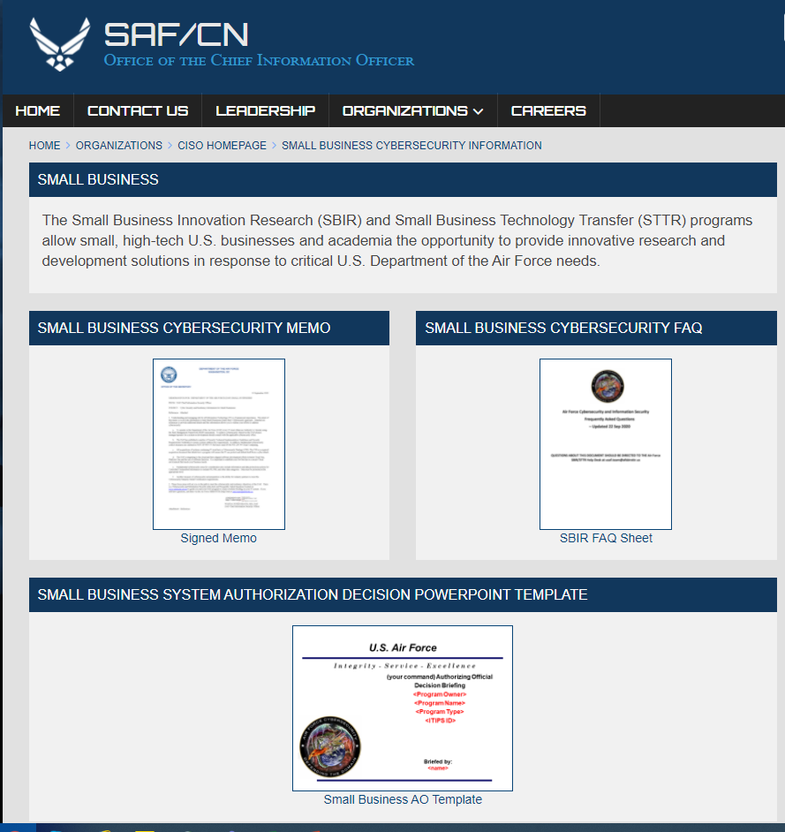
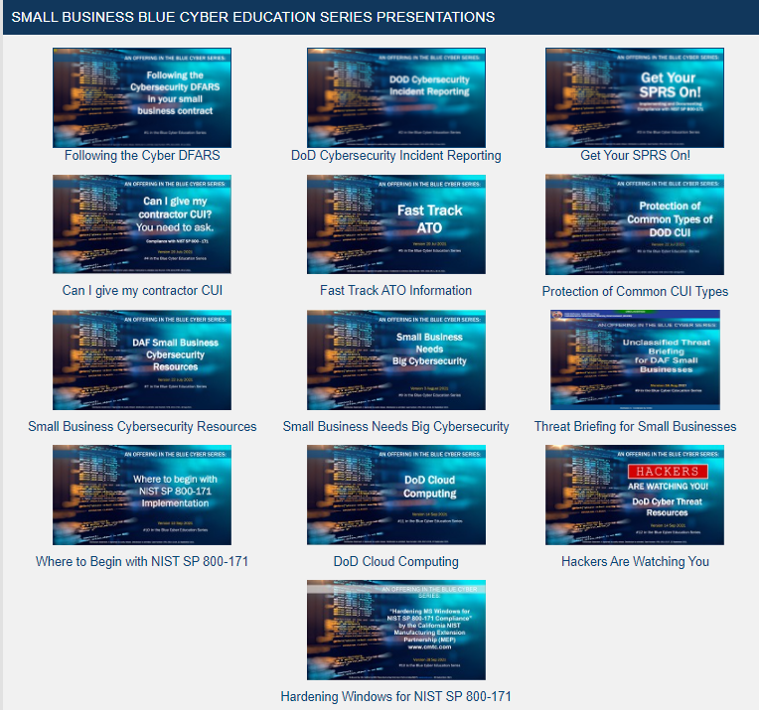
DAF CISO webpage
Blue Cyber Series https://www.safcn.af.mil/CISO/Small-Business-Cybersecurity-Information/

Slide 43
Any Questions?
This briefing is not a substitute for reading the FAR and DFARS in your contract.
This presentation and other presentations in the DAF CISO Blue Cyber Educational Series and be found on the DAF CISO webpage: https://www.safcn.af.mil/CISO/Small-Business-Cybersecurity-Information/
Please provide questions, feedback or if you just want to talk about your cyber security /data protection questions to Kelley.Kiernan@us.af.mil
  Daily Office Hours for answering/researching your questions about DAF Small Business cybersecurity and data protection!
Every Tuesday, dial in for the DAF CISO Small Business Cybersecurity Ask-Me-Anything. Register in advance for this Zoom Webinar: https://www.zoomgov.com/webinar/register/WN_6Gz84TQGRvm6YHMSVyE0Qg

Slide 44
AN OFFERING IN THE BLUE CYBER SERIES:
DoD Cybersecurity Maturity Model Certification
CMMC 2.0 Explained
12 January 2022
#15 in the Blue Cyber Education Series
Notes:
Photo source Photo by: Air Force photo | VIRIN: 201002-F-ZX772-001.JPG https://www.afnwc.af.mil/News/Photos/igphoto/2002520957/

Slide 45
What happened?
The DFARS Clause 252.204-7021, went into federal rule-making and the result was a revamp of the original plan.
  The original plan of CMMC assessments and timelines to require DoD contractors pre-certified as to their cybersecurity capabilities was found to be needing revision.
The new plan, being called CMMC 2.0, reverts the requirements to those already in place in every contract, the requirements of DFARS Clause 252.204-7012.
  There might be requirements beyond DFARS Clause 252.204-7012, for some (few) contractors, but we won’t know until late 2022 at the earliest. The DCMA direction is to focus on DFARS 7012 compliance.
    Listen to the best message on this subject from the DCMA Director here: https://www.preveil.com/resources/webinar-john-ellis-on-cmmc-2-0/
Notes:
https://www.acq.osd.mil/cmmc/faq.html

Slide 46
Why did the DoD make these changes?
  The Department values feedback from industry, Congress, and other stakeholders and received over 850 public comments in response to the interim rule establishing CMMC 1.0.
  These comments focused on the need to enhance CMMC by
  (1) reducing costs, particularly for small businesses;
  (2) increasing trust in the CMMC assessment ecosystem; and
  (3) clarifying and aligning cybersecurity requirements to other federal requirements and commonly accepted standards.
  CMMC 2.0 was designed to meet these goals, which also contribute toward enhancing the cybersecurity of the defense industrial base.
Notes:
https://www.acq.osd.mil/cmmc/faq.html

Slide 47
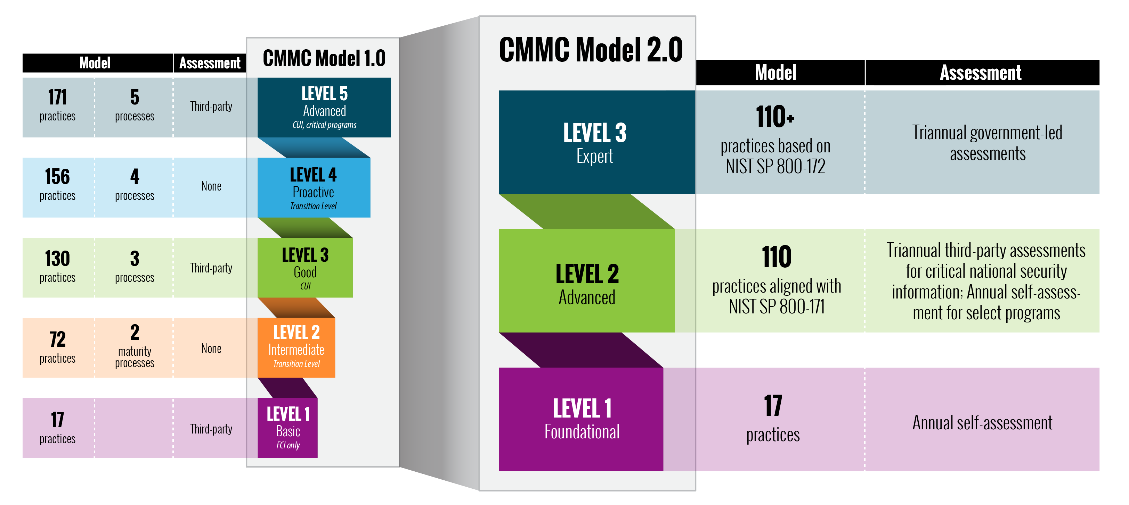
CMMC 2.0
The “Expert” level is currently under development, will be a subset of NIST SP 800-172 requirements.
The “Advanced” level will be equivalent to DFARS Clause
252.204-7012. Law since 2017
The “Foundational” level will be equivalent to the FAR Clause 252.204-21. Law since 2013
The rulemaking process and timelines can take 9-24 months. CMMC 2.0 will become a contract requirement once rulemaking is completed. The publication of materials relating to CMMC 2.0 reflect the Department’s strategic intent with respect to the CMMC program; however, CMMC 2.0 will not be a contractual requirement until the Department completes rulemaking to implement the program.
Notes:
Table from https://www.acq.osd.mil/cmmc/about-us.html

Slide 48
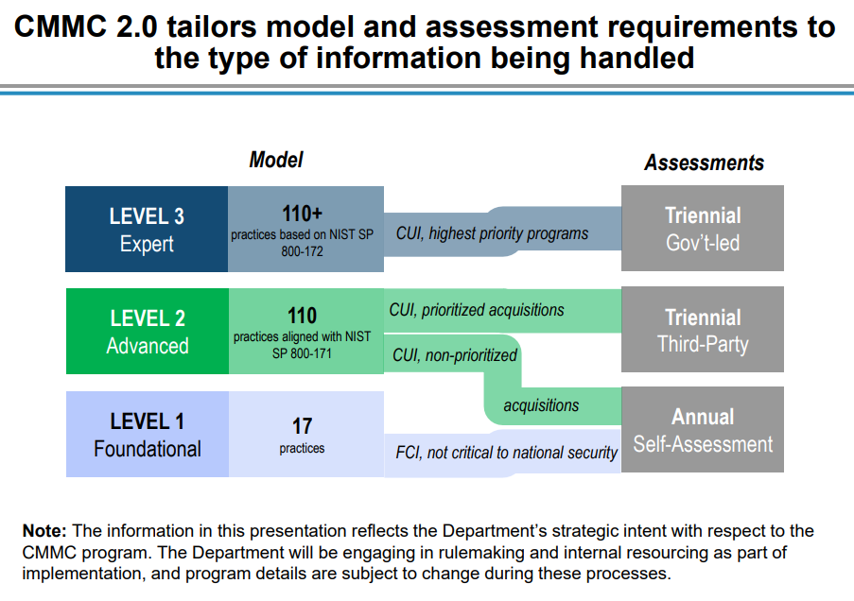
DoD Depiction of Proposed Assessments
LATE 2022 AT THE EARLIEST
Notes:
Dr. Dees slide to Town Hall in early Nov 2021

Slide 49
Proposed Self-Assessments
LATE 2022 AT THE EARLIEST
The Department views Level 1 (“Foundational”) as an opportunity to engage its contractors in developing and strengthening their approach to cybersecurity. Because Level 1 does not involve sensitive national security information, DoD intends for this Level to allow companies to assess their own cybersecurity and begin adopting practices that will thwart cyber-attacks.
Likewise, a subset of programs with Level 2 (“Advanced”) requirements do not involve information critical to national security, and associated contractors will only be required to conduct self-assessments.
Contractors will be required to conduct self-assessment on an annual basis, accompanied by an annual affirmation from a senior company official that the company is meeting requirements. The Department intends to require companies to register self-assessments and affirmations in the Supplier Performance Risk System (SPRS).

Slide 50
Proposed Overview of Assessments
LATE 2022 AT THE EARLIEST
CMMC 2.0 implements tiered assessment requirements based on the sensitivity of the information shared with a contractor.
Upon implementation of CMMC 2.0:
Contractors who do not handle information deemed critical to national security (Level 1 and a subset of Level 2) will be required to perform annual self-assessments against clearly articulated cybersecurity standards.
Contractors managing information critical to national security (a subset of Level 2) will be required to undergo third-party assessments.
The highest priority, most critical defense programs (Level 3) will require government-led assessments.

Slide 51
Plan of Actions and Milestones (POA&Ms)
LATE 2022 AT THE EARLIEST
With the implementation of CMMC 2.0, the Department intends to allow companies to receive contract awards with a Plan of Actions and Milestones (POA&M) in place to complete CMMC requirements.
The Department’s intent is to specify a baseline number of requirements that must be achieved prior to contract award, in order to allow a remaining subset to be addressed in a POA&M within a clearly defined timeline.
The Department also intends to specify a small subset of requirements that cannot be on a POA&M in support of achieving a CMMC certification.

Slide 52
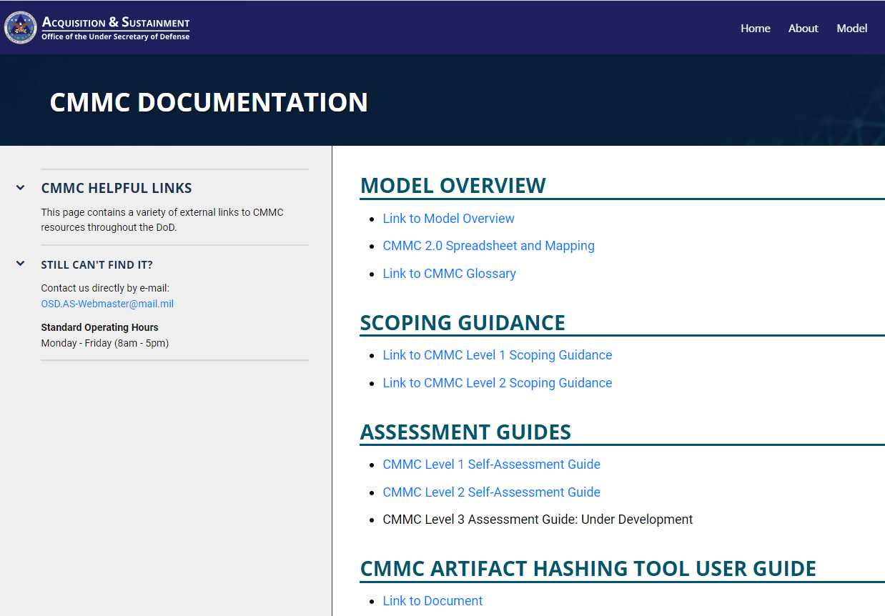
New Documentation Guides
https://www.acq.osd.mil/cmmc

Slide 53
So what has changed?
A re-focus on the FAR and DFARS requirements.
FAR Clause 252.204-21 still requires 15 security controls with no POAM. Law since 2013.
This is the proposed Foundational Level of CMMC 2.0
DFARS Clause 252.204-7012 still requires 110 security controls implemented as the definition of adequate protection for DoD CUI. Law since 2017.
This is the proposed Advanced Level of CMMC 2.0
CMMC 2.0 will become a contract requirement once rulemaking is completed. Late 2022 at the earliest.
DFARS Clause
252.239-7010
Cloud Computing Services
FAR Clause
252.204-21
Basic Safeguarding
of Covered
Contractor
Information Systems
DFARS Clause
252.204-7012, Safeguarding Covered Defense Information and Cyber Incident Reporting
DFARS Clause 252.204-7008 Compliance with safeguarding
covered defense information controls
DFARS Clause 252.204-7019/20
NIST SP 800-171 DoD Assessment Requirements.
DFARS Clause
252.204-7021
Cybersecurity Maturity Model Certification Requirement

Slide 54
Resources
DoD OSD A&S CMMC 2.0 Webpage
  https://www.acq.osd.mil/cmmc/index.html
CMMC 2.0 FAQ (changing every week)
  https://www.acq.osd.mil/cmmc/faq.html
How will my organization know what CMMC level is required for a contract?
  Once CMMC 2.0 is implemented, DoD will specify the required CMMC level in the solicitation and in any Requests for Information (RFIs), if utilized.
Will my organization need to be certified if it does not handle CUI?
  DoD’s intent under CMMC 2.0 is that if a DIB company does not process, store, or transmit Controlled Unclassified Information (CUI) on its unclassified network, but does process, store or handle Federal Contract Information (FCI), then it must perform a CMMC Level 1 self-assessment and submit the results with an annual affirmation by a senior company official into SPRS.
Notes:
https://www.acq.osd.mil/cmmc/faq.html

Slide 55
Any Questions?
This briefing is not a substitute for reading the FAR and DFARS in your contract.
This presentation and other presentations in the DAF CISO Blue Cyber Educational Series and be found on the DAF CISO webpage: https://www.safcn.af.mil/Organizations/CISO-Homepage/Small-Business-Cybersecurity-Information/
Please provide questions, feedback or if you just want to talk about your cyber security /data protection questions to Kelley.Kiernan@us.af.mil
  Daily Office Hours for answering/researching your questions about DAF Small Business cybersecurity and data protection!
  Every Tuesday, dial in for the DAF CISO Small Business Cybersecurity Ask-Me-Anything. Register in advance for this Zoom Webinar: https://www.zoomgov.com/webinar/register/WN_CHsGAoWXTJSU5cDvEmQQHQ

Slide 56
The Blue Cyber Education Series for DoD Small Businesses on
DAF CISO webpage www.safcn.af.mil/Organizations/CISO-Homepage/Small-Business-Cybersecurity-Information/
Every Tuesday Small Business Cybersecurity Ask-Me-Anything
Register in advance for this Zoom Webinar: https://www.zoomgov.com/webinar/register/WN_CHsGAoWXTJSU5cDvEmQQHQ

